Slide 1
RAMADDA
Repository for Archiving and MAnaging Diverse DAta
https://ramadda.org
In development since 2008 – runs at UCAR, NOAA, Universities, etc
Combines
Content management system/Wiki
Scientific data repository
Visualization environment
Technology
Open source - https://github.com/geodesystems/ramadda
Java based – runs on any platform
Runs stand-alone or in a servlet container (e.g., Tomcat)
Workshop site – https://ramadda.unidata.ucar.edu/repository/a/sipi_ntu

Slide 2
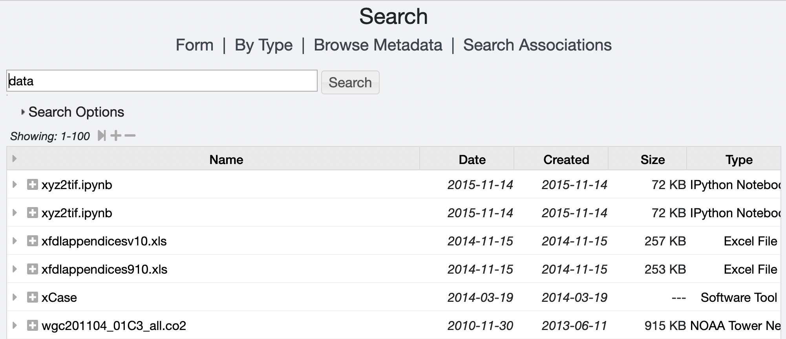
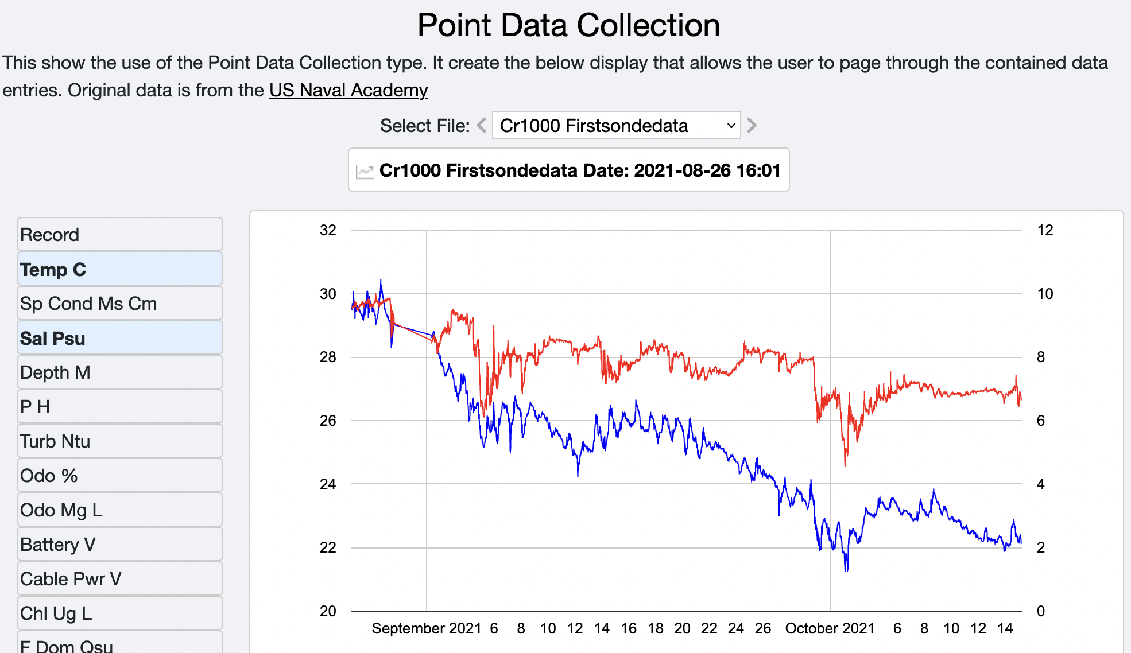
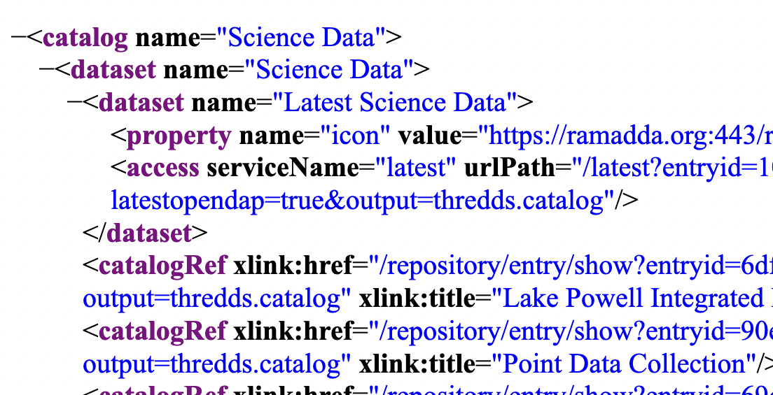
RAMADDA Model
Hierarchy of typed entries
Search
Folder
Tag
Wiki text &
displays
Keyword
Docs
Data
Wiki page
Image
Cr1000.csv
Services
Catalogs
Data, etc
Alias
Thumbnail
Properties attached to entries

Slide 3
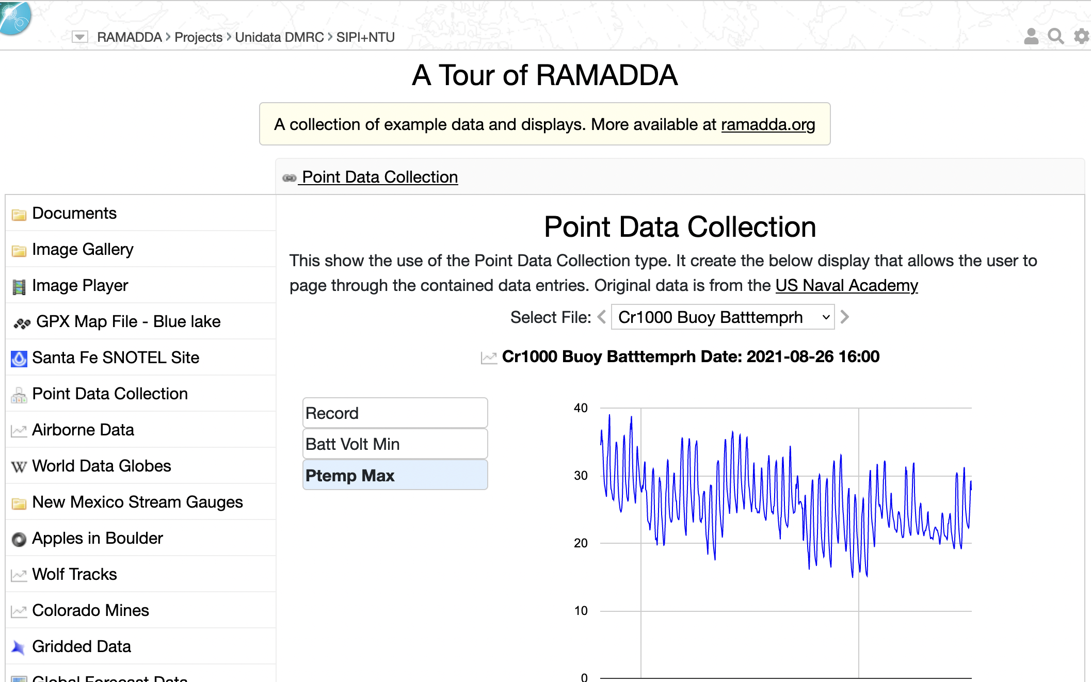
A Tour of RAMADDA
https://ramadda.unidata.ucar.edu/repository/a/ramadda_tour

Slide 4
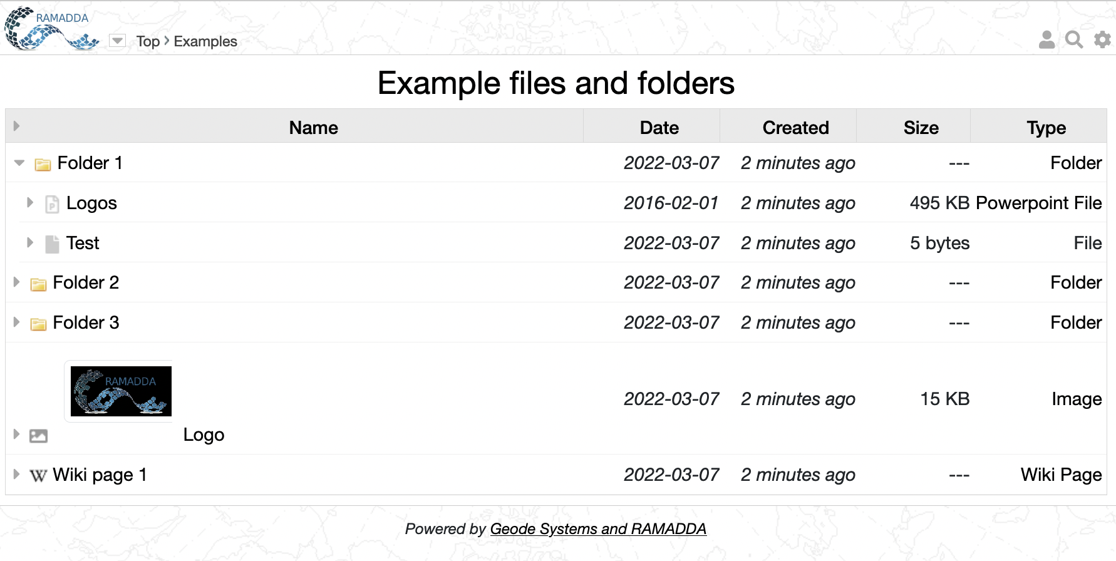
Entry Display
Login, search, settings, help
Breadcrumbs
You are always viewing an entry.
Here it is a folder called “Example files..”
Click on an arrow to open in place
Click on a link to go to that entry
There are folders, files
and other types of entries

Slide 5
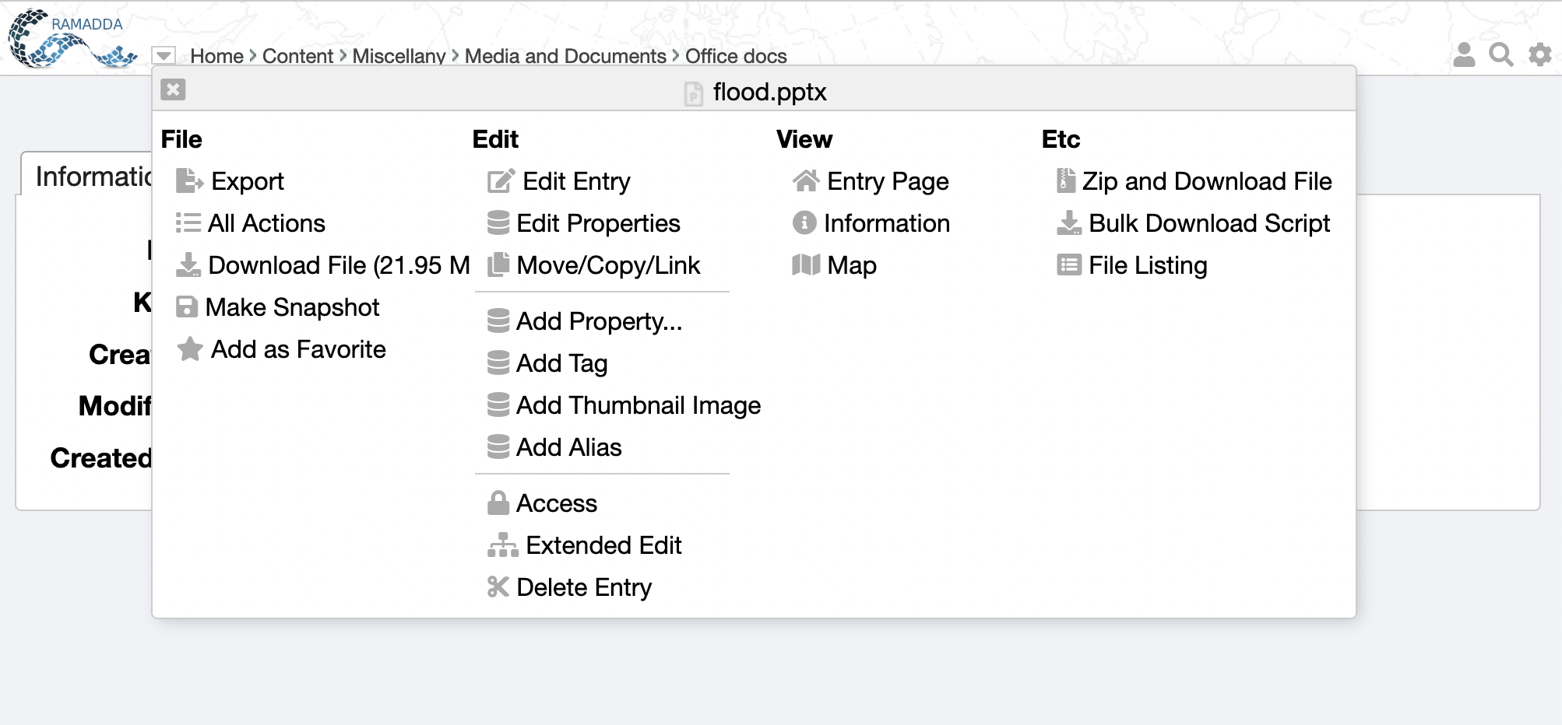
Entry Popup Menu
Popup menu
Information
All actions

Slide 6
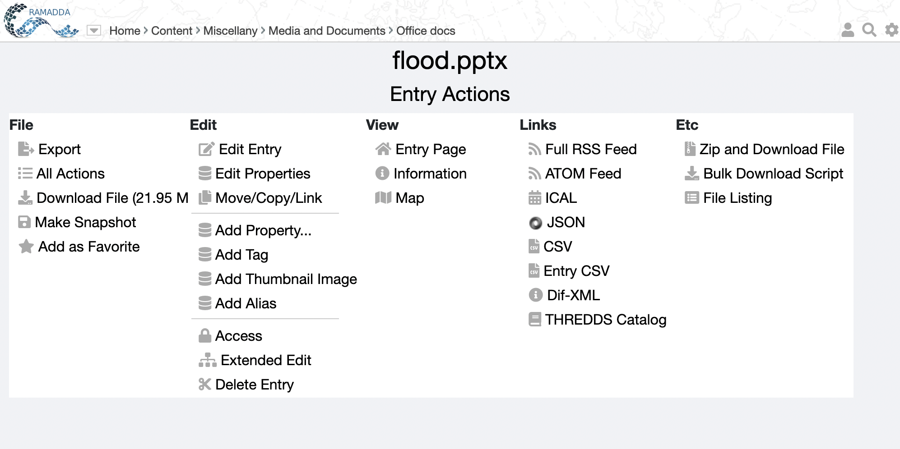
All Actions
All Action
Many ways to view and access an entry

Slide 7
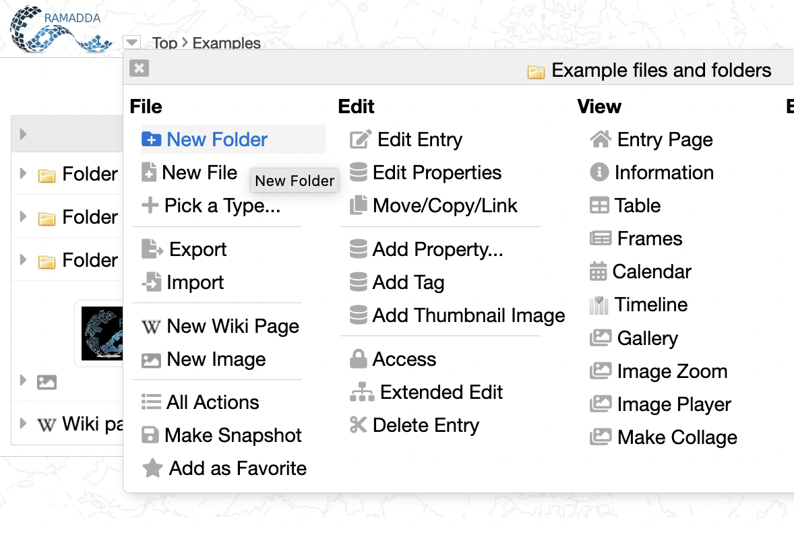
New Folder
Now we’re going to create some content. Login and go to your home entry. Click on the entry popup menu and select “New Folder”

Slide 8
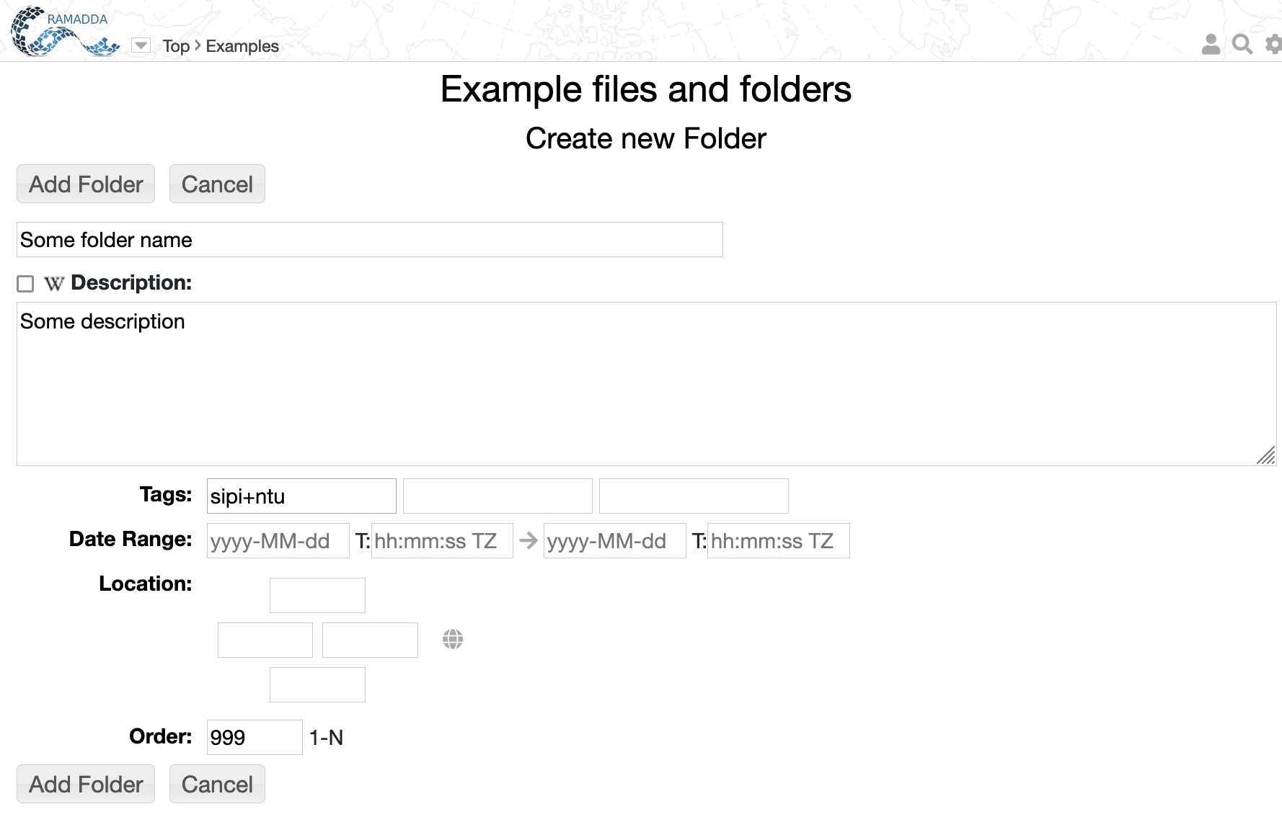
New Folder
Enter a name and some description
You can add multiple tags

Slide 9
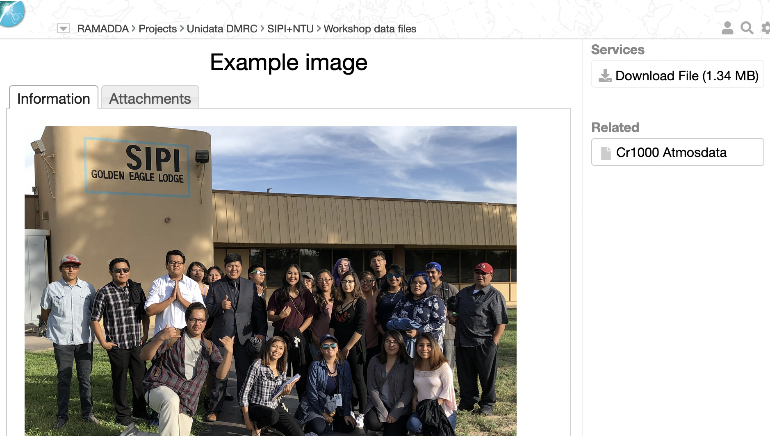
New Files
Now we’re going to upload some files
First – go to the Workshop Files ->Example image
https://ramadda.unidata.ucar.edu/repository/a/workshop_files
Download the image file and save it to disk

Slide 10
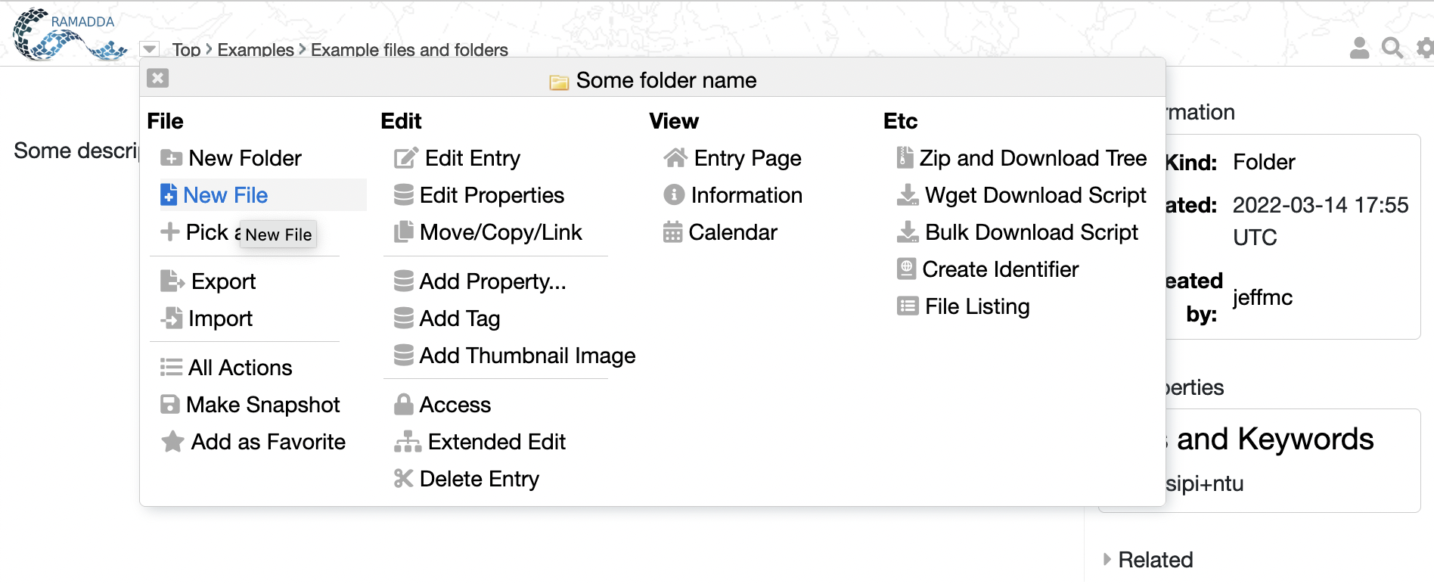
New Files
Now, go back to the new folder entry you just created and click on the entry popup menu and choose New File
Choose New File

Slide 11
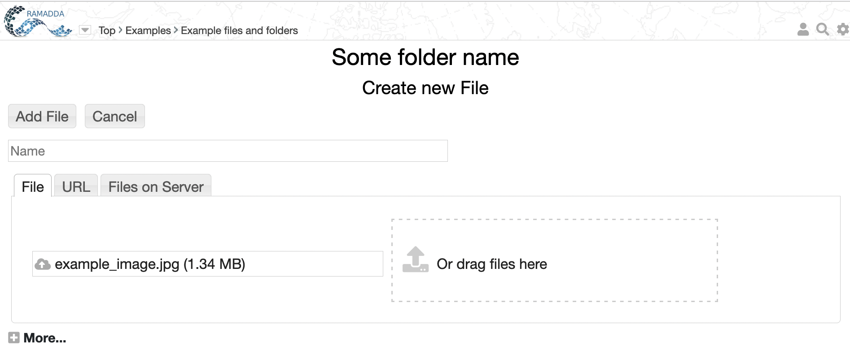
New Files
Select the example image file and press Add File

Slide 12
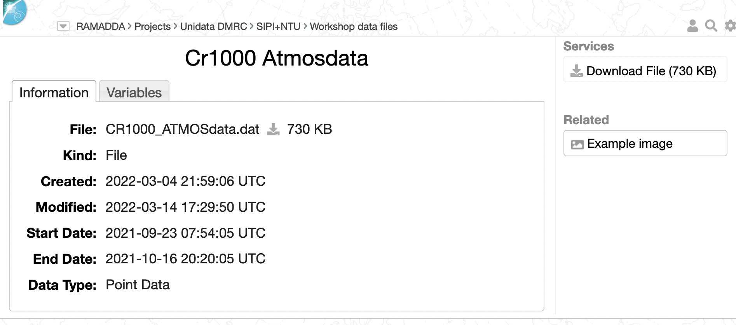
New Files – Specifying the Type
Now we’re going to upload a data file
First – go to the Workshop Data Files ->Cr1000 Atmosdata entry
and download the data file and save it to disk

Slide 13
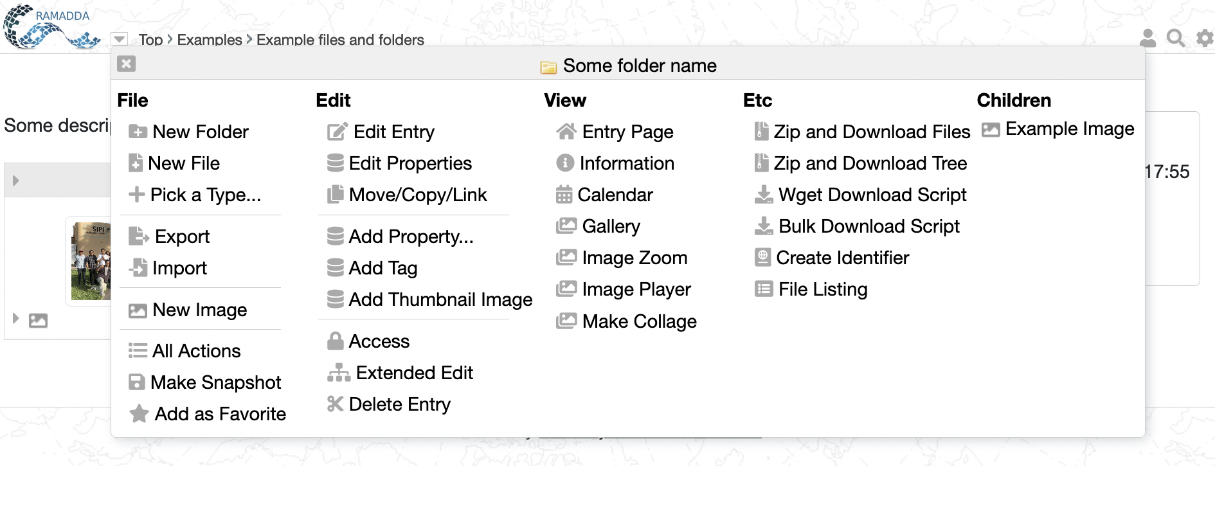
New Files – Specifying the Type
Now go back to your new folder
This time select “Pick a Type…”
Pick a type

Slide 14
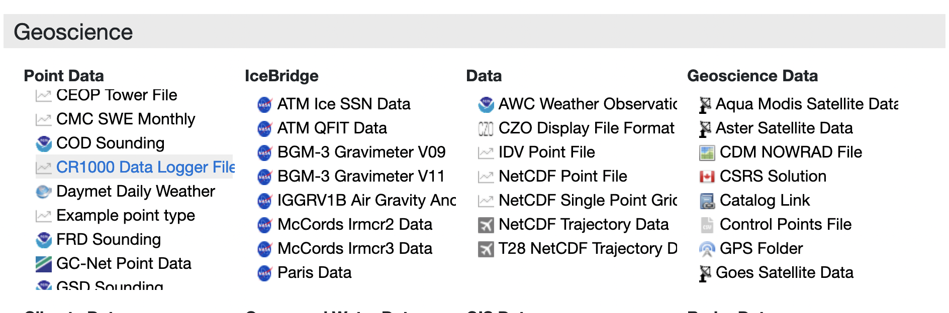
New Files – Specifying the Type
As you can see RAMADDA supports many different entry types.
Under Geoscience->Point Data select CR1000 Data Logger File

Slide 15
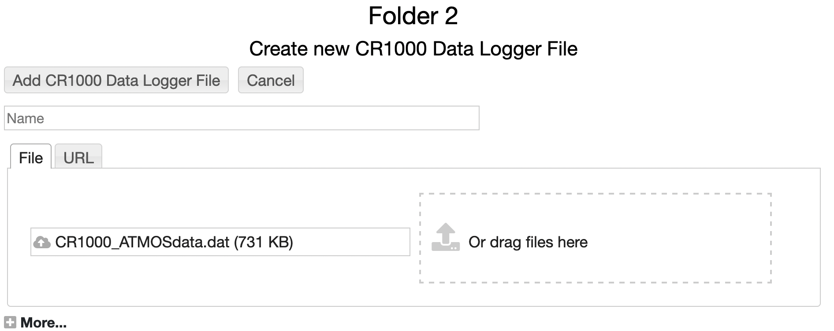
New Files – Specifying the Type
Select the data file you just downloaded and press “Add CR1000 Data Logger File”

Slide 16
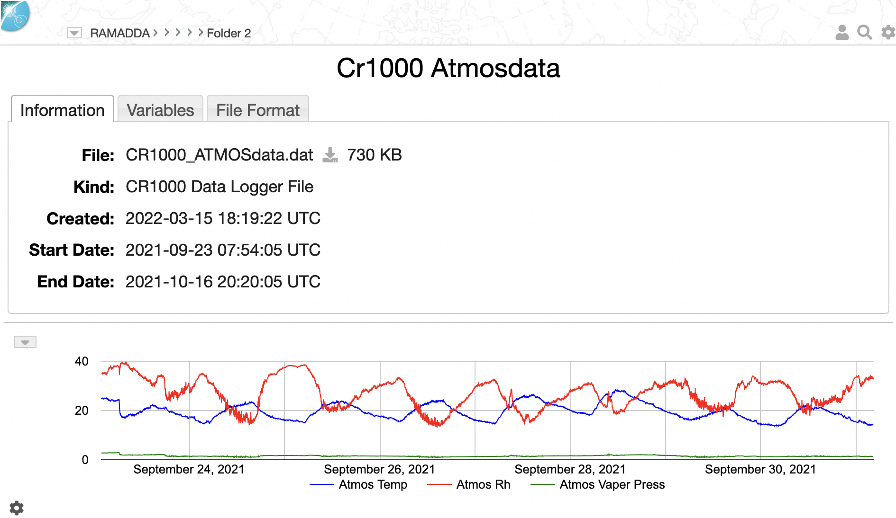
New Files – Specifying the Type
RAMADDA will process the file, extracting temporal and other metadata.
The default view of the CR1000 Data Logger entries is the metadata information and an interactive line chart

Slide 17
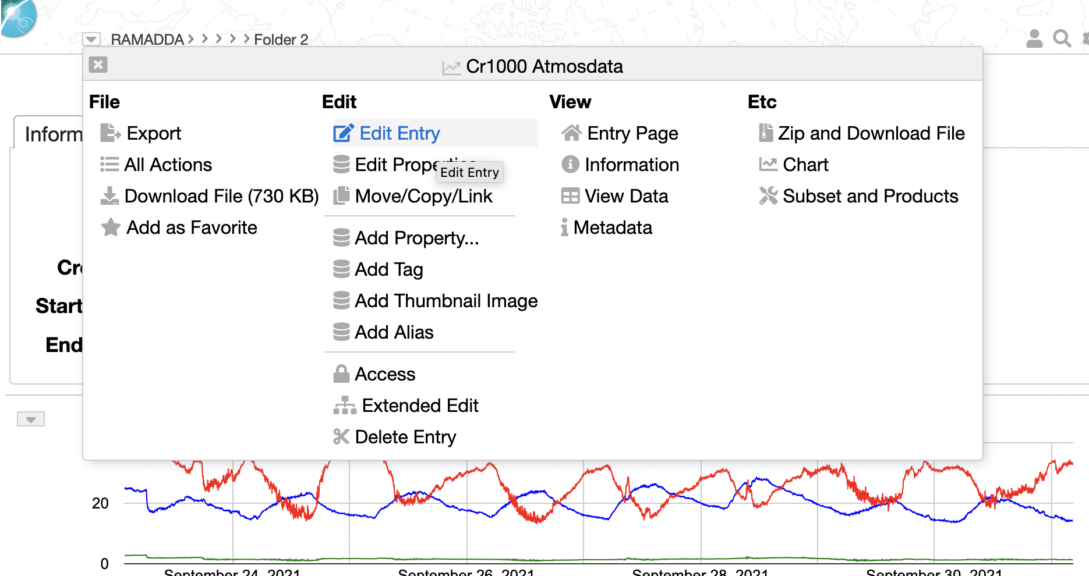
Editing, Deleting, etc
Through the entry popup menu you can select Edit Entry, Edit Properties, Add Property, Delete Entry, etc
Export – returns a zip file with entry information and any files. Go ahead and export this entry. Go to the parent folder and do an Import
Let’s go look at the Edit Properties, Add Property, etc

Slide 18
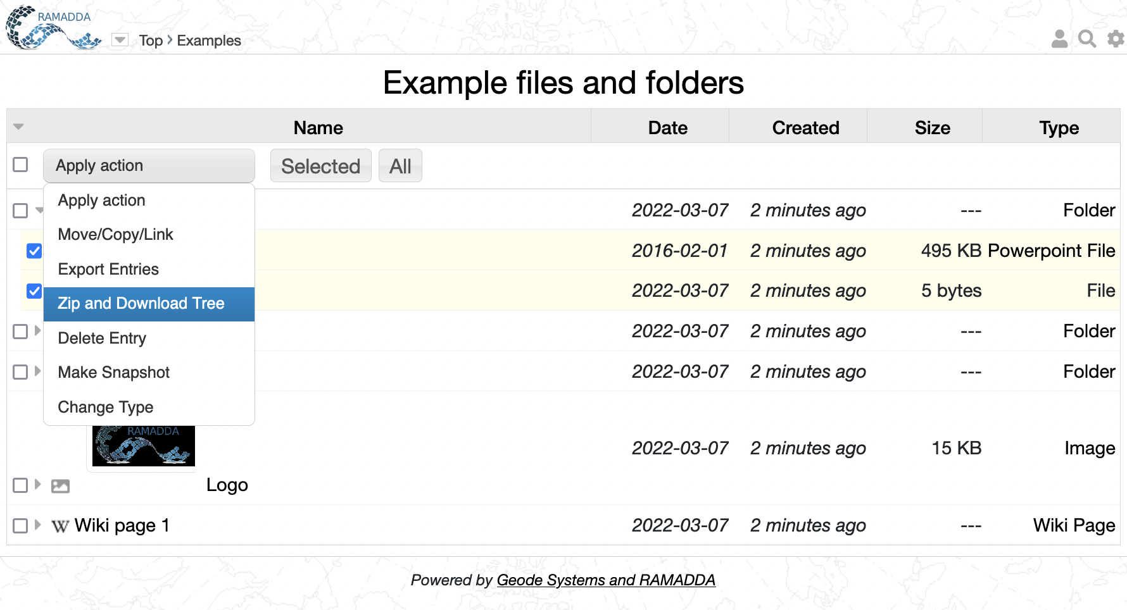
Managing multiple entries
Now we’re going to look at how to manage multiple entries
Toggle form
Select action
Do it
Select entries

Slide 19
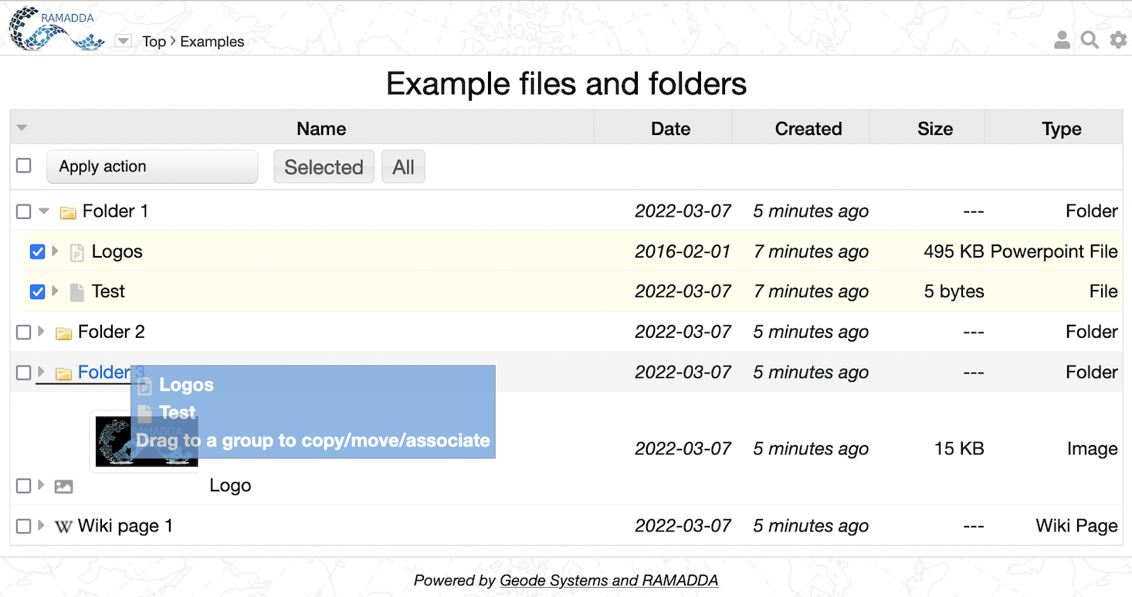
Drag-and-Drop
Click and drag on an icon
Drop it on the destination entry

Slide 20
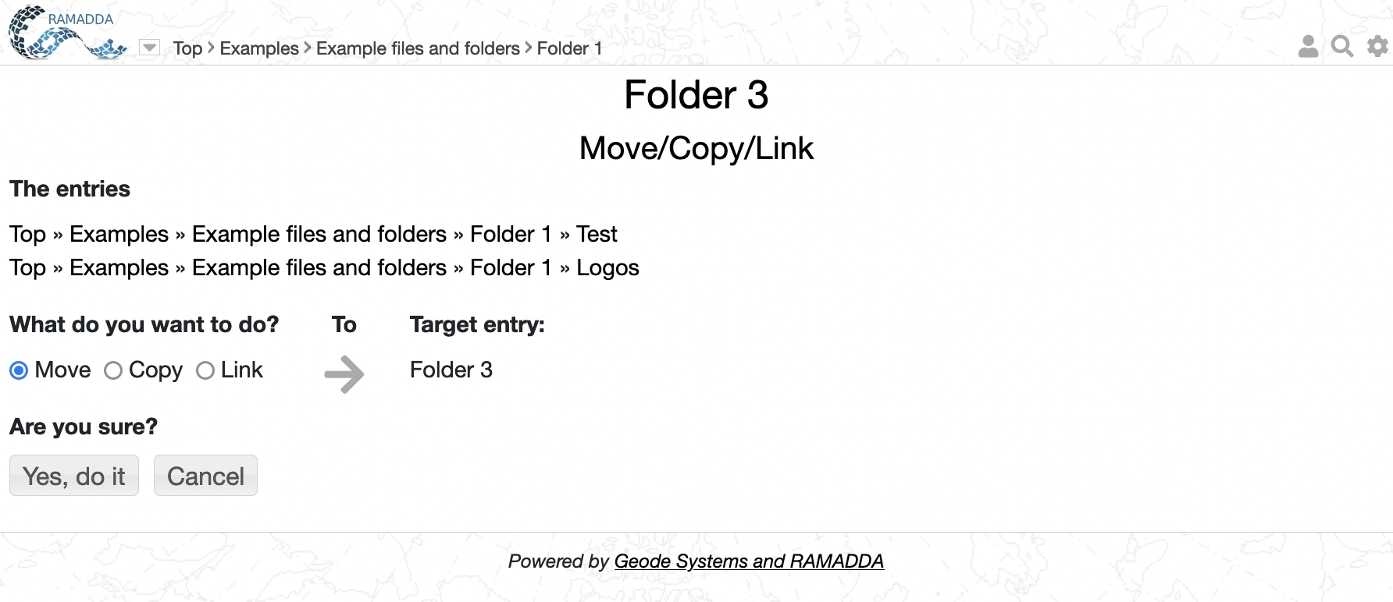
Move/Copy Confirm
Select action

Slide 21
Entry Access
RAMADDA has a hierarchical action/role access control
Users, IP address and user roles are granted or denied rights to perform actions
Actions are-
View – can the entry be accessed at all
Edit/New/Delete – can users edit entries, create new entries, etc
File – Can the file associated with the entry be downloaded
Export – Can the entry be exported
Anonymous upload – Can anonymous users upload files (will be quarantined until an admin makes the file public
Let’s see this in action

Slide 22
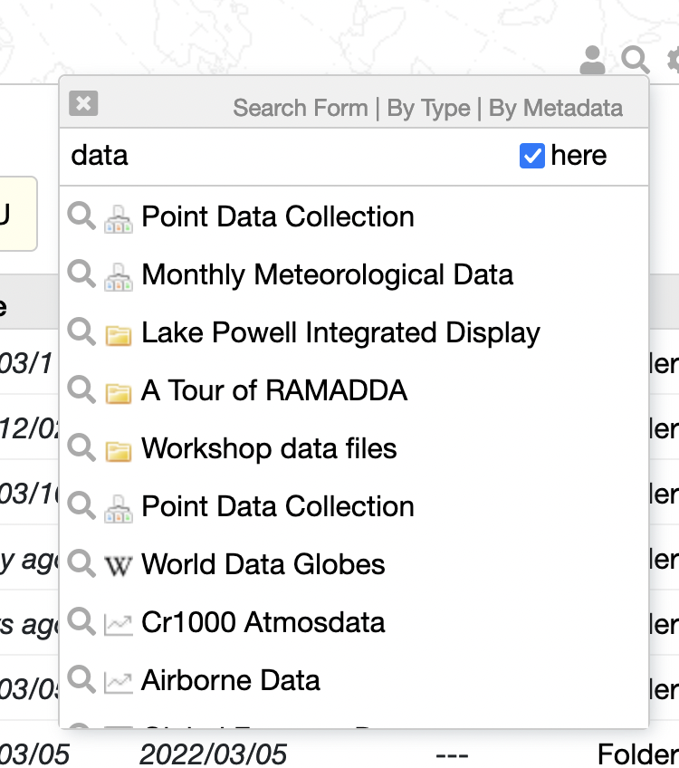
Search – In Place
Go to other search pages
Search button
All RAMADDA or just under current entry

Slide 23
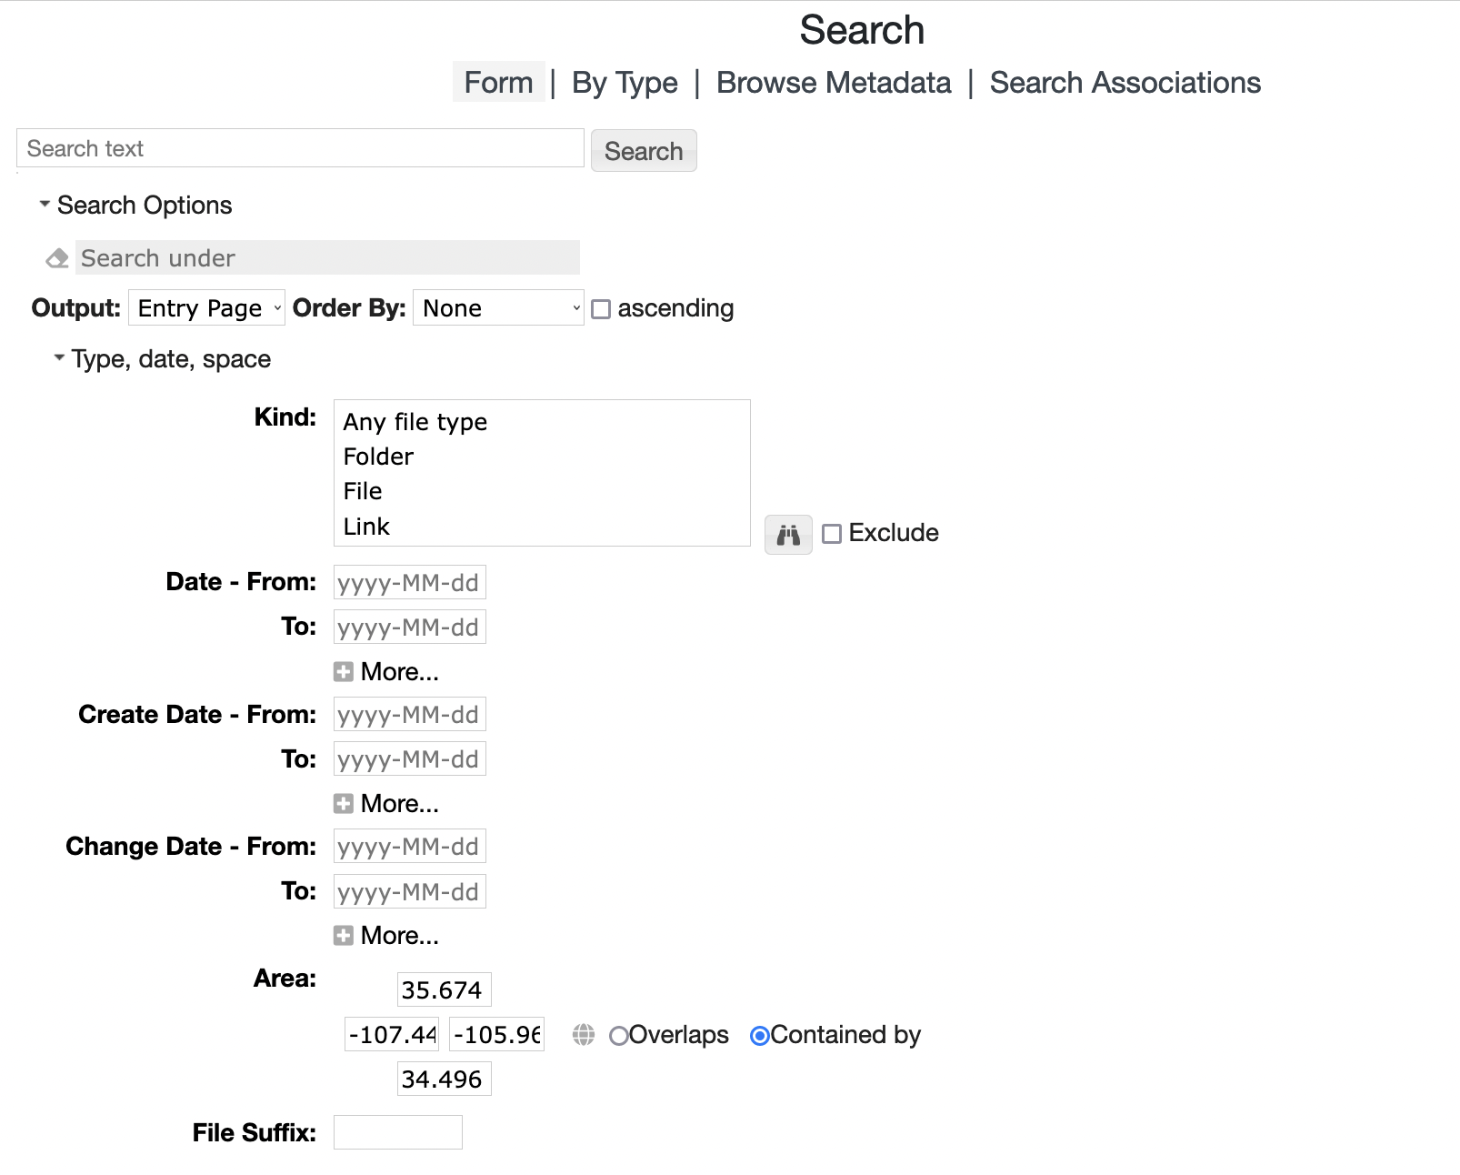
Search - Form
Entry type search
Temporal search
Spatial search
Check on “Contained by”
Select an area and Search

Slide 24
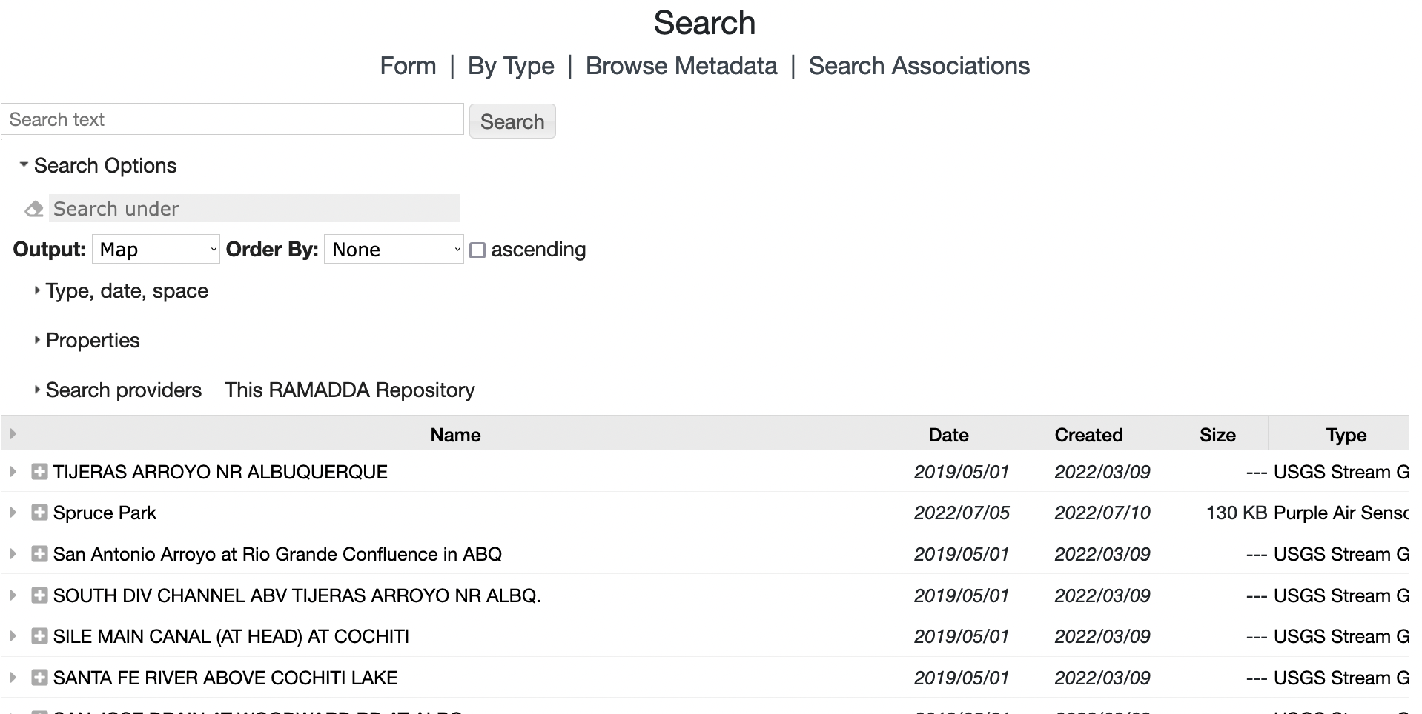
Search - Form
Change Output to Map and Search again

Slide 25
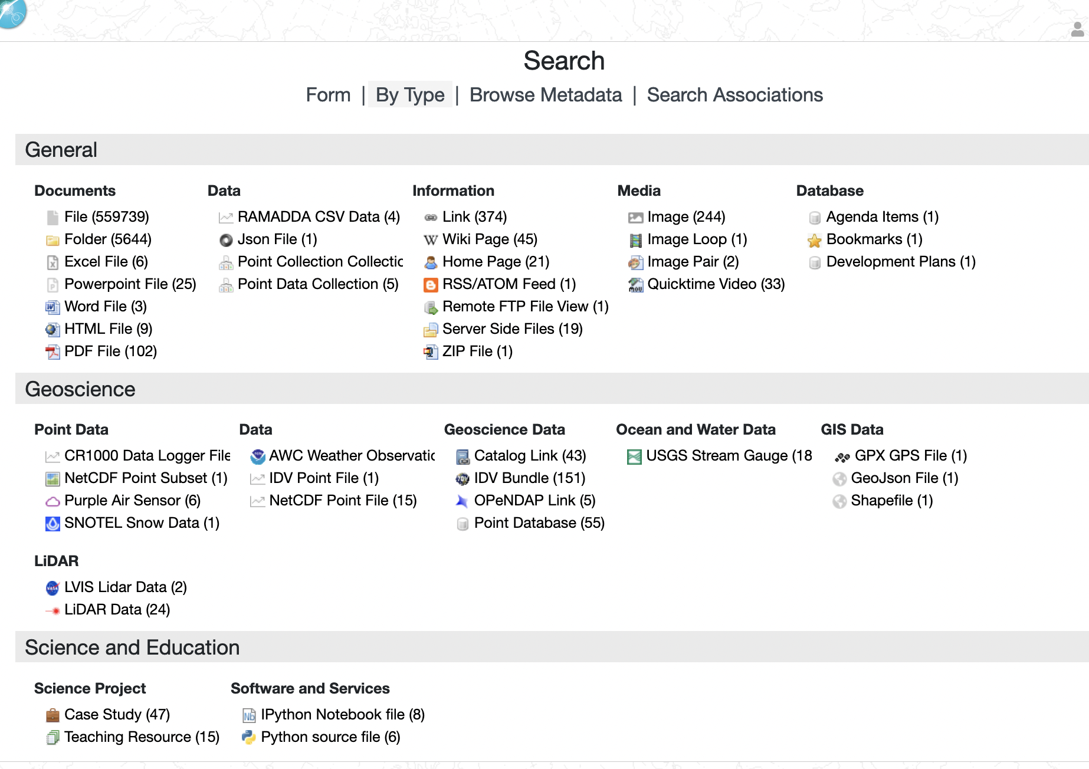
Search by Type
This shows all of the entry types in this RAMADDA
Select Purple Air Sensor

Slide 26
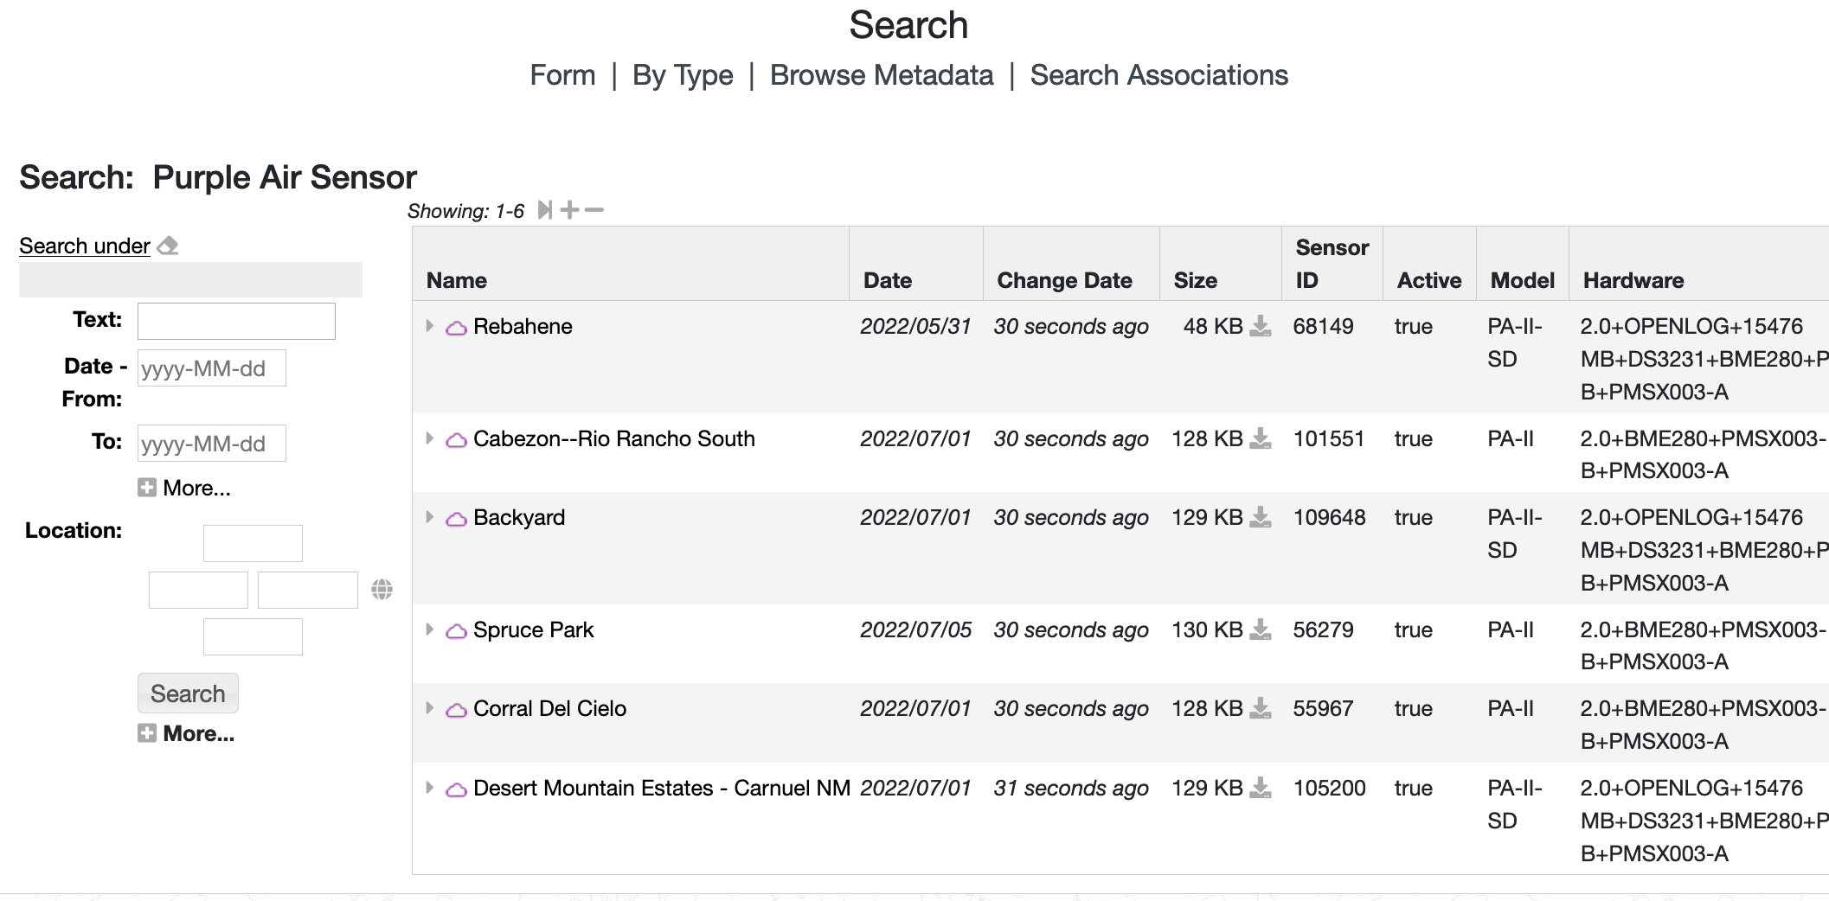
Search by Type

Slide 27
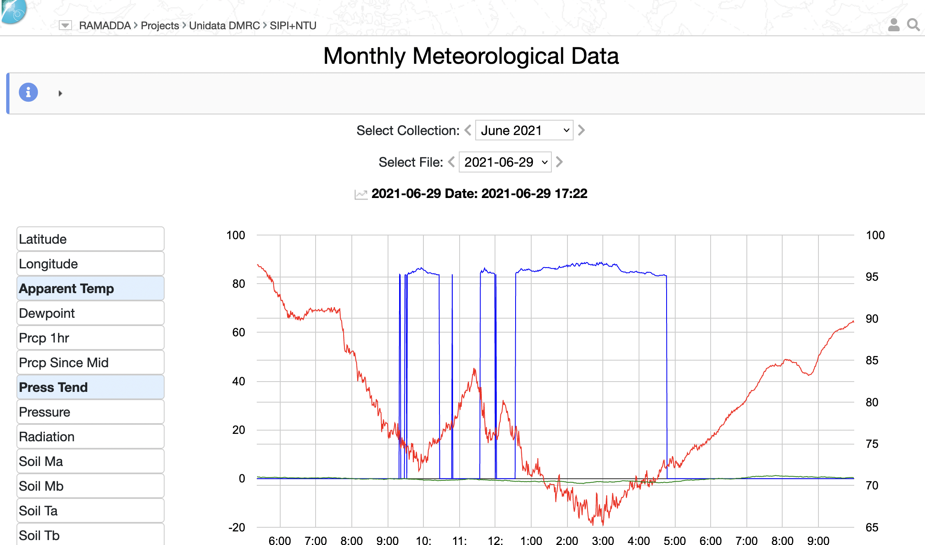
Point Data Collection of Collections
Let’s look at the Monthly Meteorological Data
This is a specialized entry that contains any number of children Point Data Collection entries – a collection of collections.
Select the month
Page through the files

Slide 28
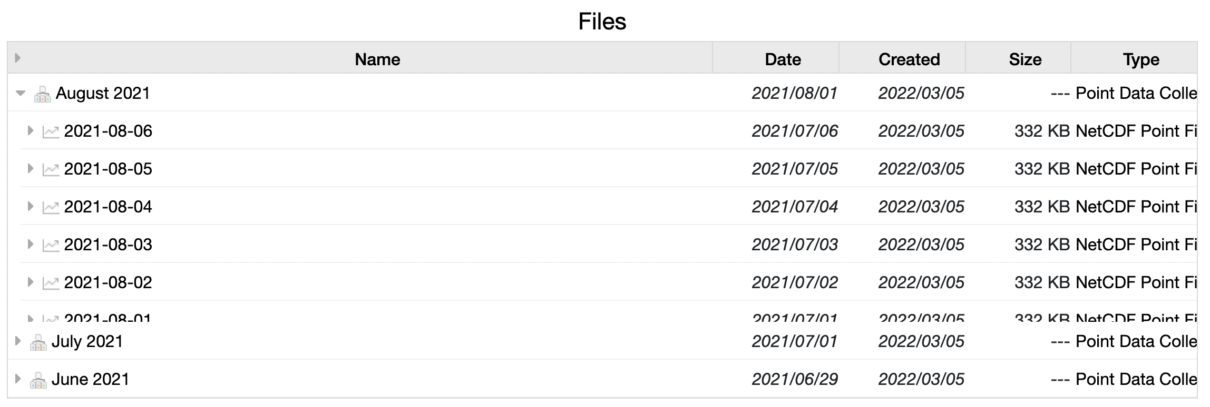
Point Data Collection
Scrolling down we can see the tree of entries.
The children entries are each of type Point Data Collection
The data files are NetCDF Point files
Let’s look at August 2021
Select action

Slide 29
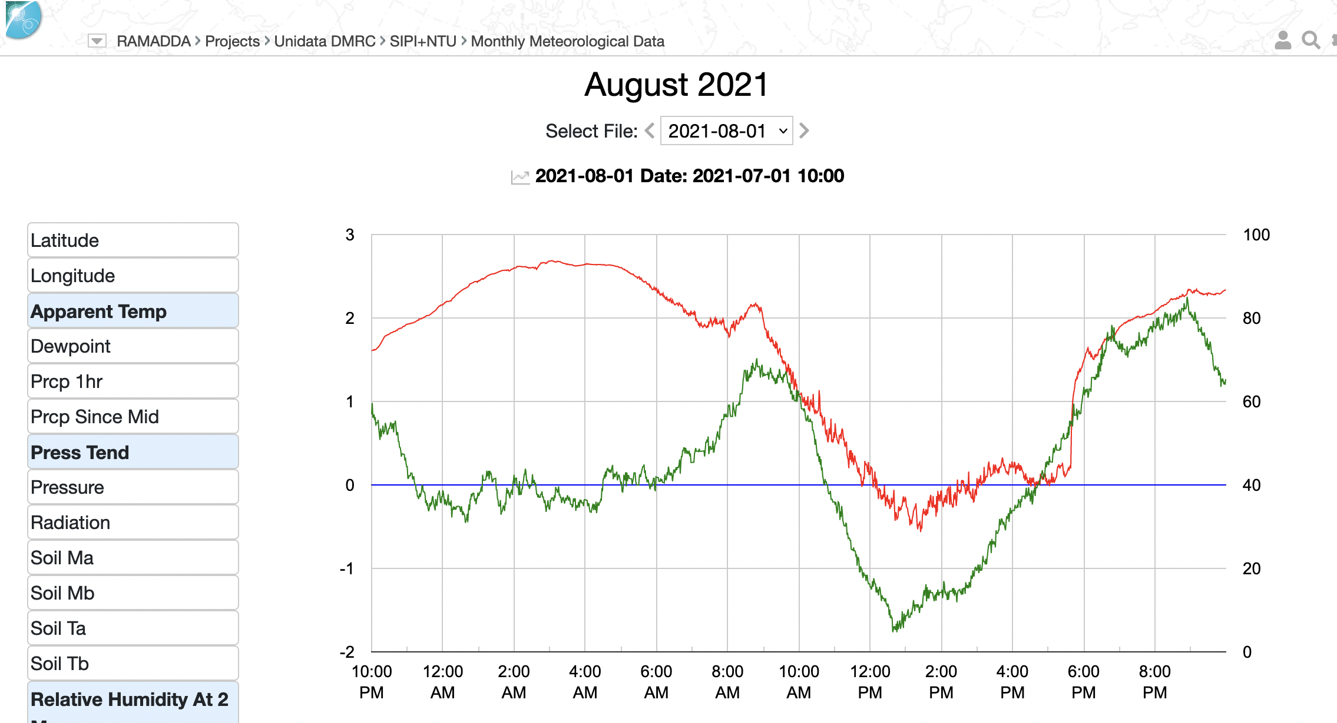
Point Data Collection
Now, scroll down and let’s go look at a particular data file

Slide 30
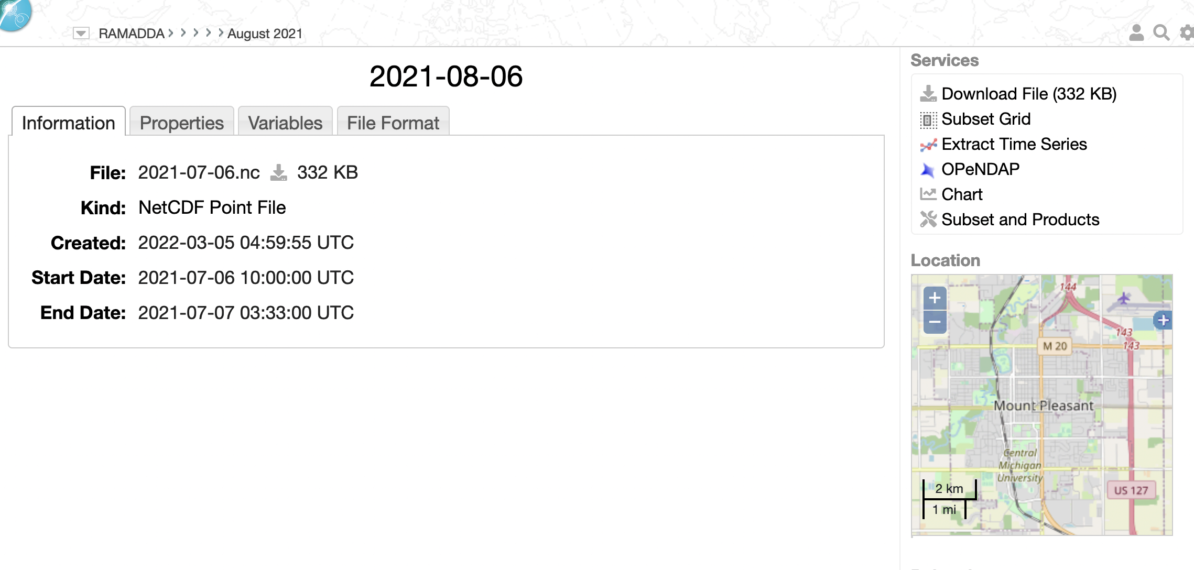
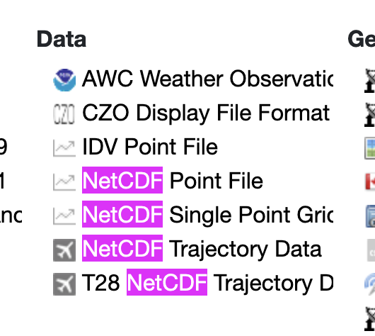
NetCDF Point File
Temporal, spatial and faceted metadata automatically extracted
Now, download the above file
Go to your local home directory and choose Pick a Type…
Choose “NetCDF Point File”

Slide 31
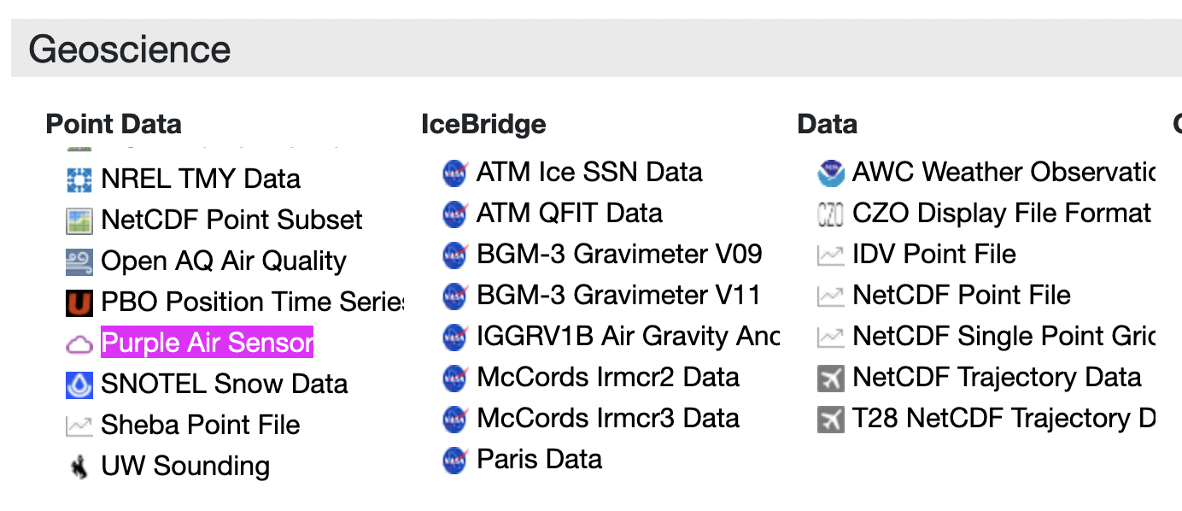
Create Purple Air Sensors
Create a folder, e.g. “Purple Air”
Select “Pick a type…” from the entry menu
Select Purple Air Sensor

Slide 32
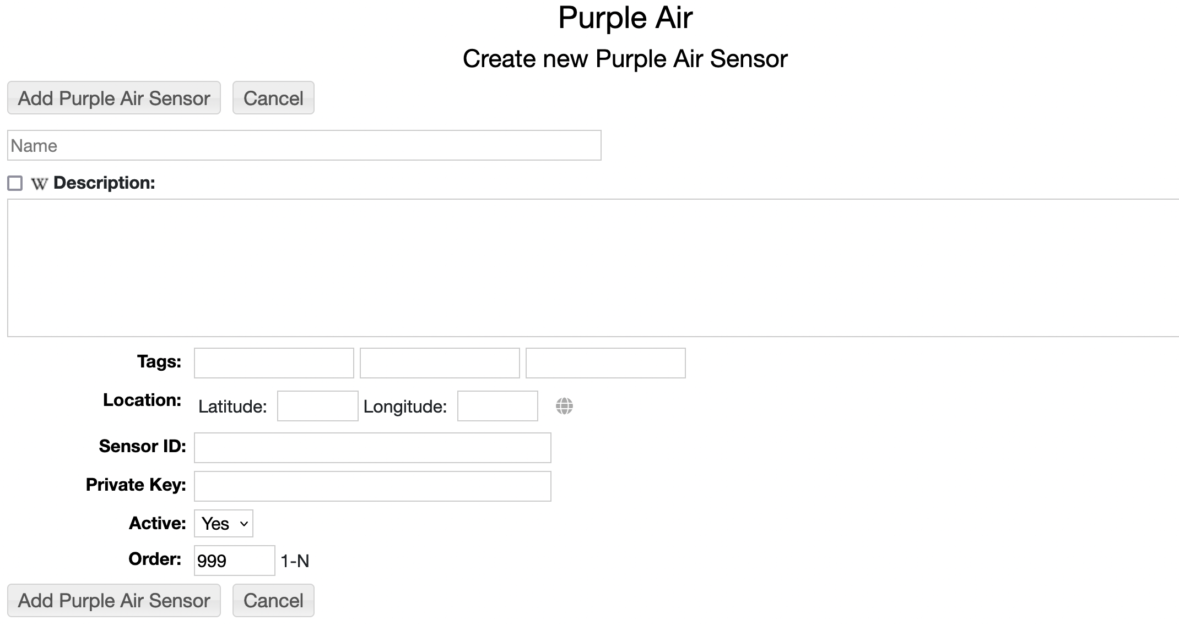
Create Purple Air Sensors
All you need to specify is a Sensor ID
In another window go to the Purple Air site - https://map.purpleair.com
Sensor ID

Slide 33
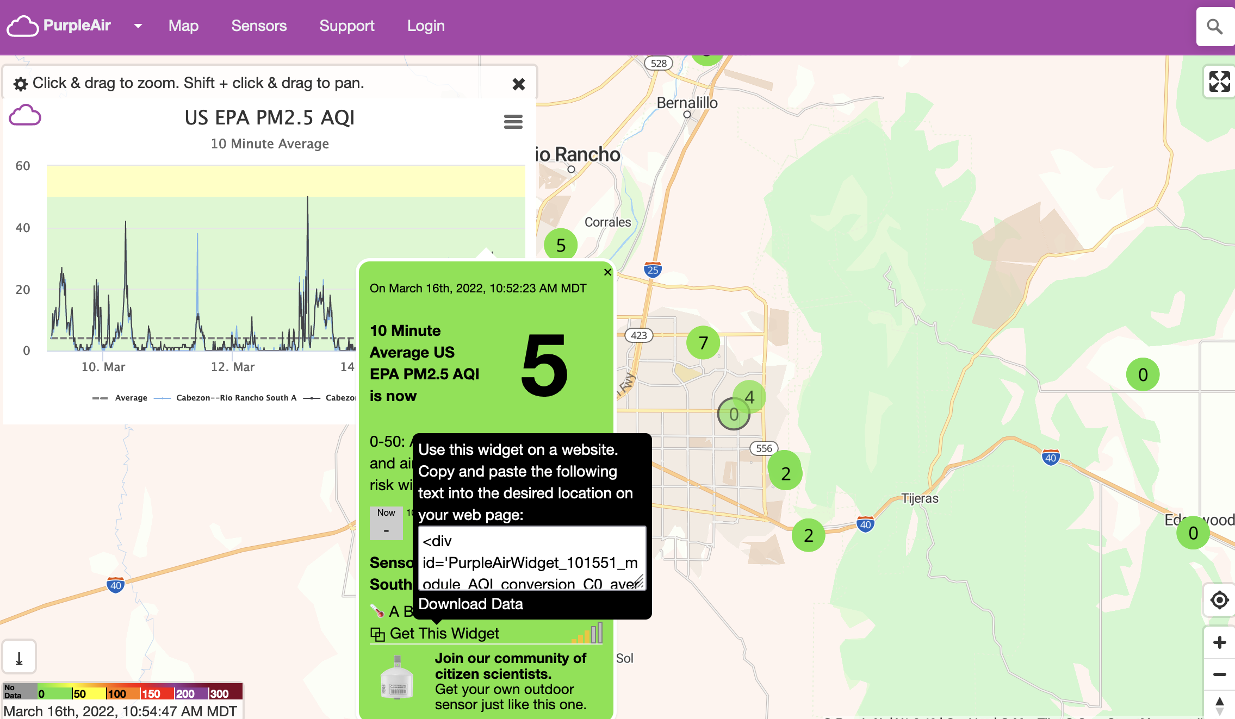
Create Purple Air Sensors
Select a site
Mouse over “Get this widget”
The site id, e.g., is 101551
Remember that number – go back to RAMADDA and enter the sensor ID
Sensor Key

Slide 34
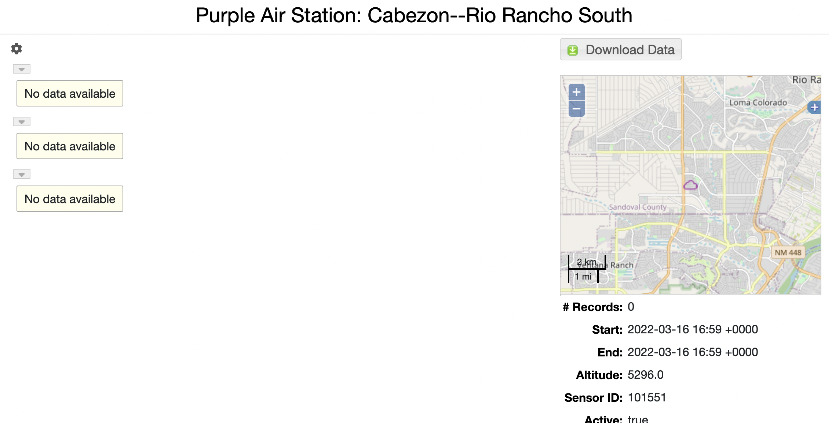
Create Purple Air Sensors
RAMADDA fetches site metadata from Purple Air
Note: New data is fetched from Purple Air periodically so initially no data is available
Sensor Key

Slide 35
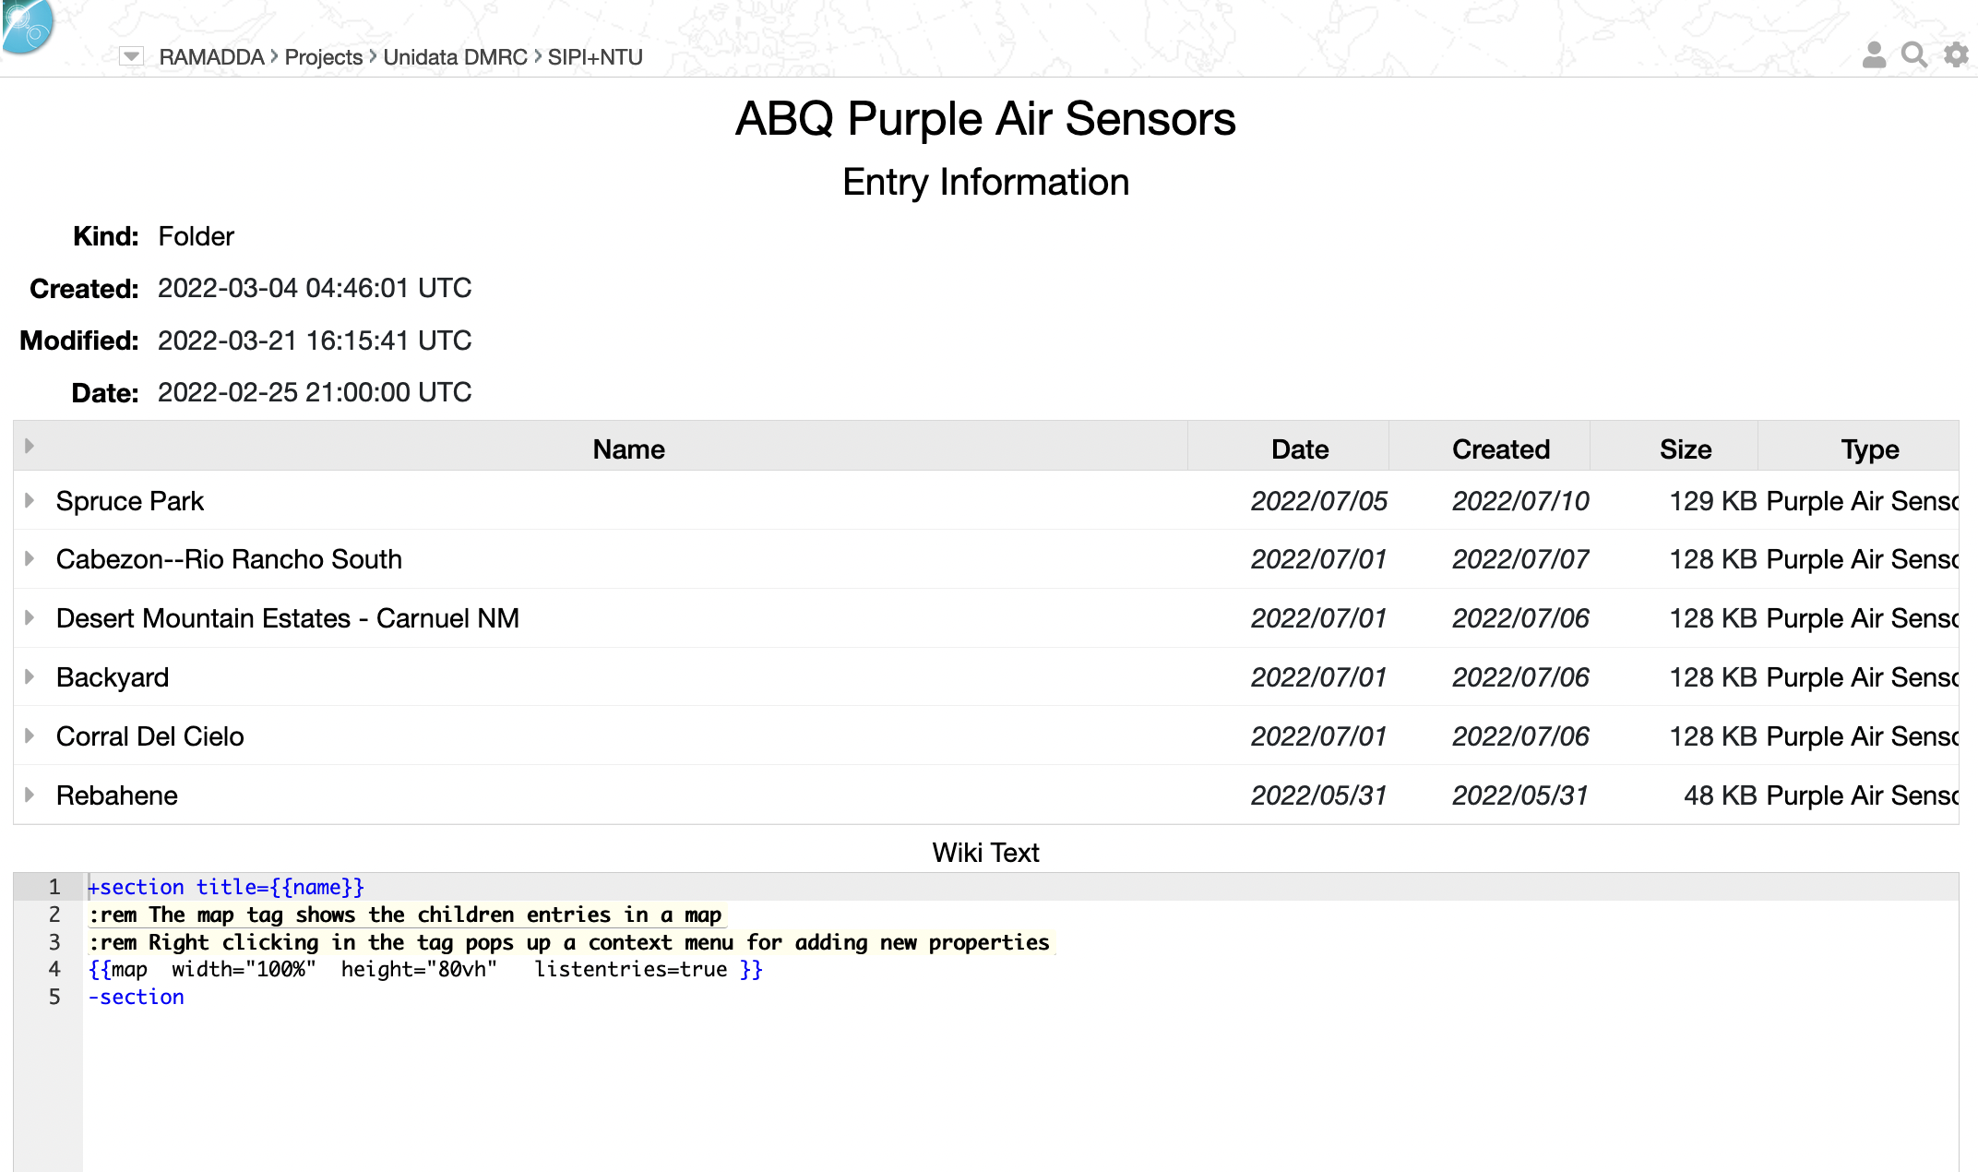
Wiki Displays
All of the displays in RAMADDA are defined using a special wiki text
Let’s go look at the Information page for the ABQ Purple Air Sensors page
At the bottom is the wiki text that is used

Slide 36
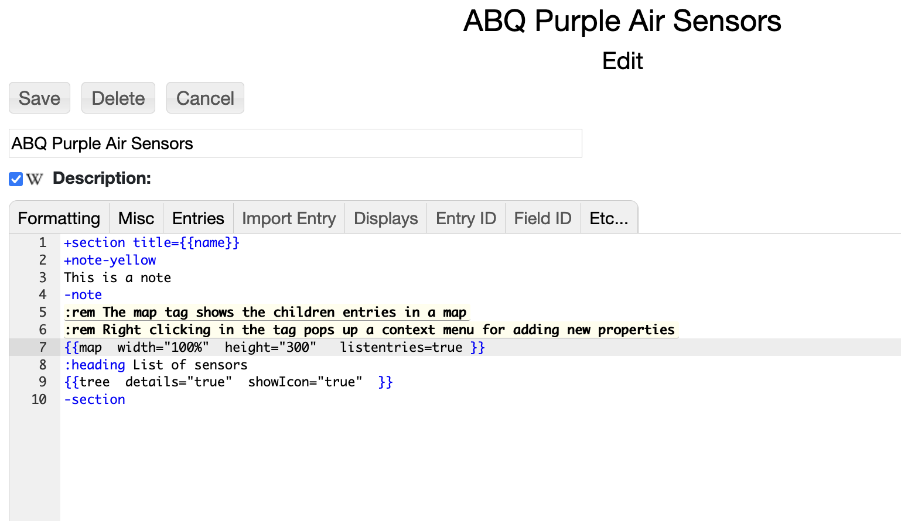
Wiki Displays
Now, I’m going to edit this page
Change the height of the map to 300
Under the Formatting menu add a note
Under the Misc menu add a Heading
Under the Entries menu add a tree view

Slide 37
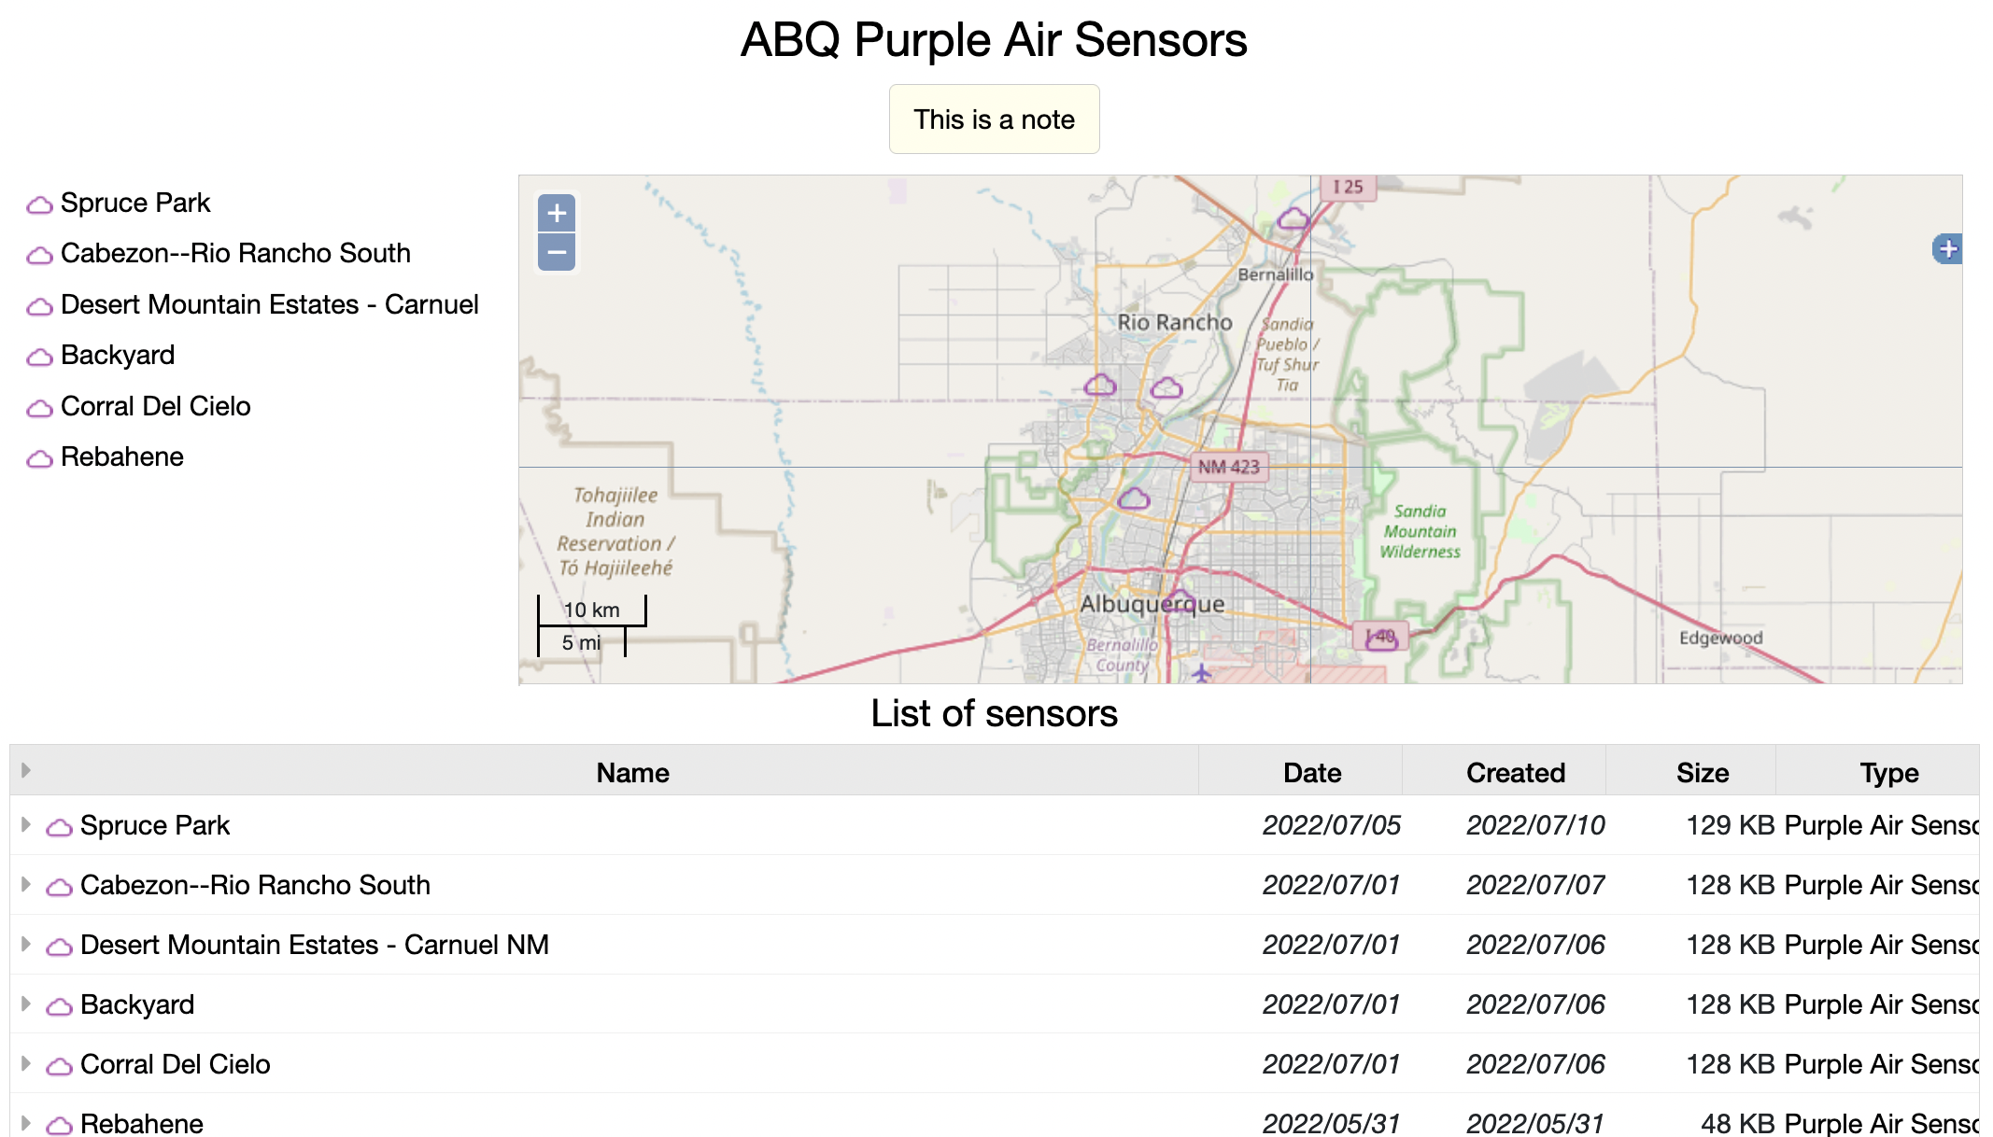
Wiki Displays

Slide 38
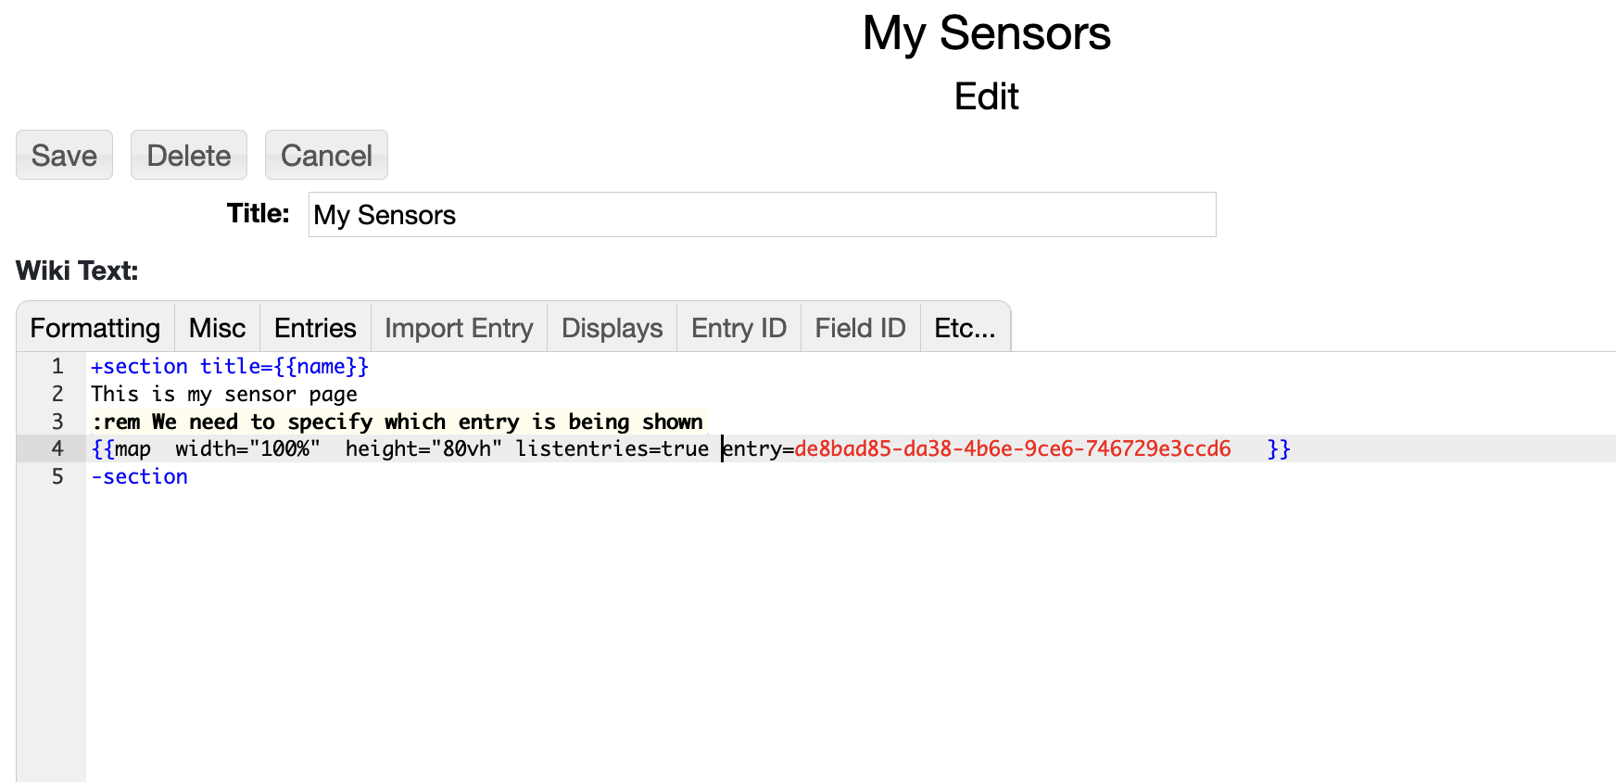
Wiki Displays
Now, let’s create our own wiki page of the sensors
In your home folder select Pick a Type…-> Wiki Page
Give it a name, e.g. “My Sensors”
Under Formatting add a Section tag
Under the Entries menu select Map. Add listentries=true if its not there
Add “entry=“ and select the ABQ Purple Air Sensors entry from the Entry ID menu
Need to specify which entry the map is for using the Entry ID menu

Slide 39
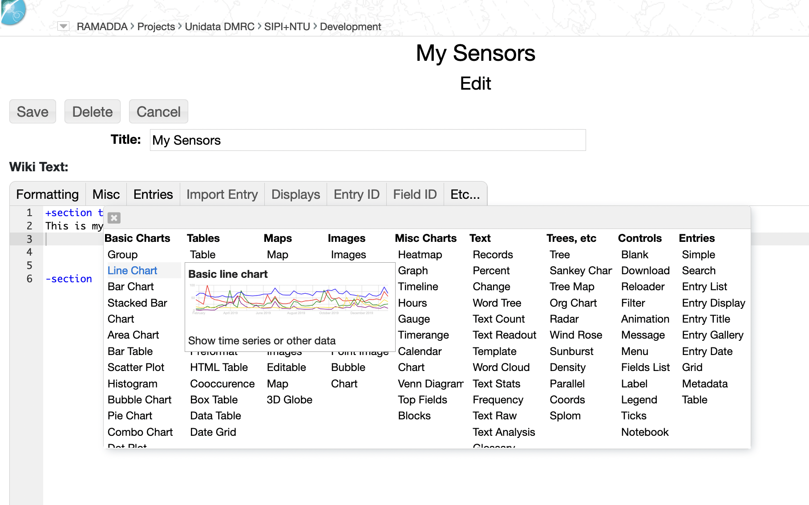
Wiki Displays
Now, instead of a map let’s show some data
Edit your My Sensors entry
Delete the {{map…}} tag
Under the Displays menu select Line Chart

Slide 40
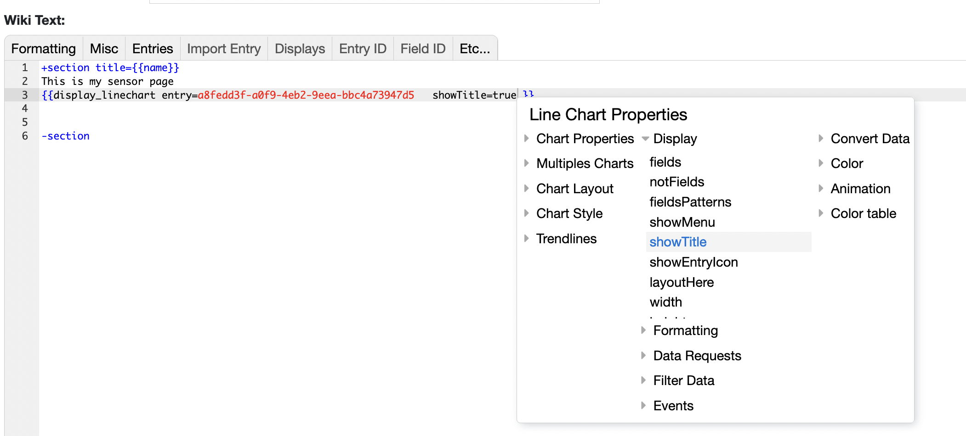
Wiki Displays
We need to specify which entry is to be shown.
Under the Entry ID menu select one of the Purple Air sensors
Right click in the tag – under Display add showTitle

Slide 41
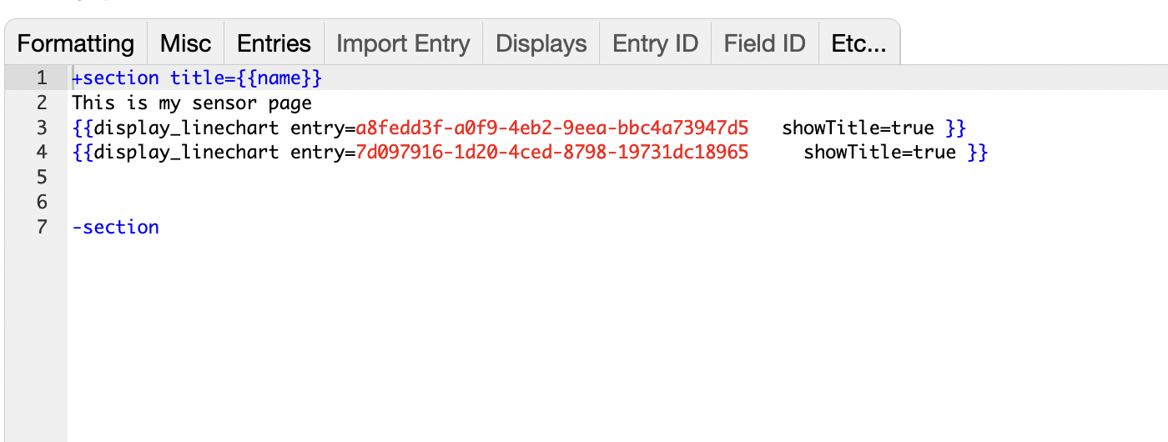
Wiki Displays
Let’s add another sensor to this page
Go back to edit My Sensors
Copy the display_linechart tag
Specify another Purple Air Sensor for the entry

Slide 42
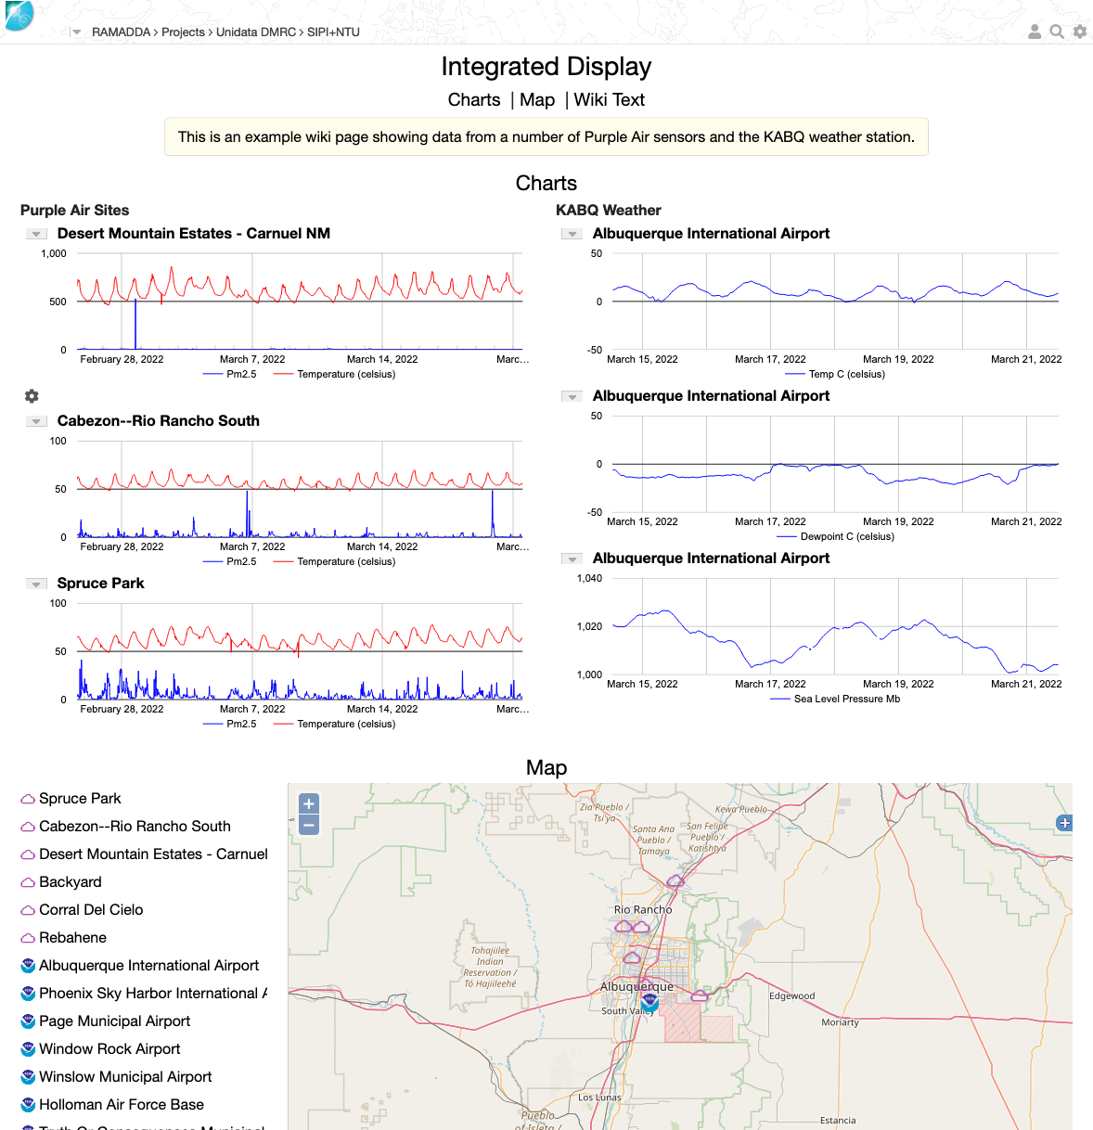
Integrated Display
Here is a more complex example
Go to the Information page and under Wiki Text copy the text
Go to your My Sensors page and delete the old text and paste this text

Slide 43
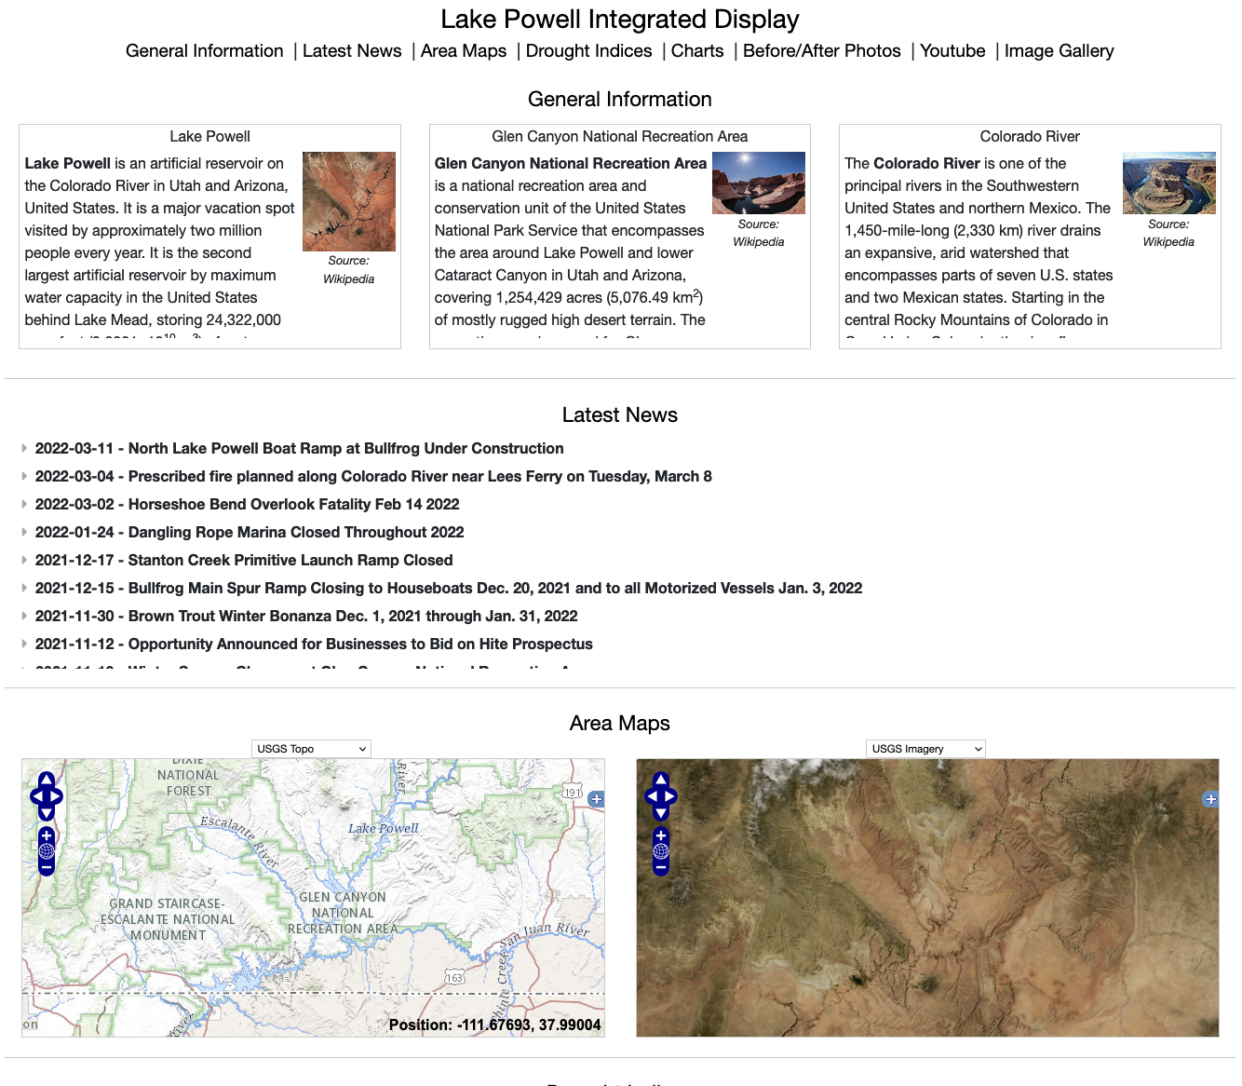
Lake Powell Integrated Display
https://ramadda.unidata.ucar.edu/repository/a/lake_powell

Slide 44
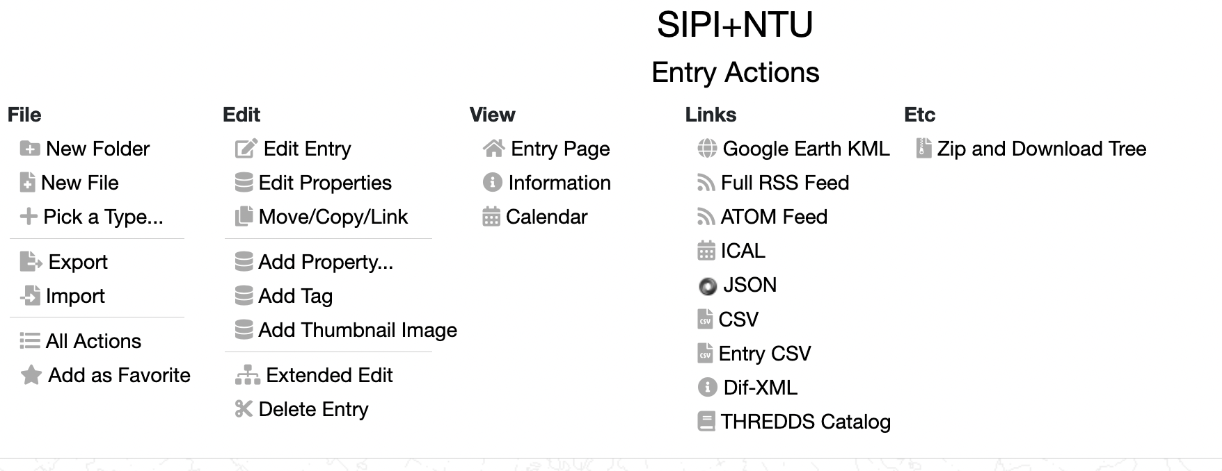
IDV/RAMADDA Catalogs
Go to the “All Actions” page for SIPI+NTU
View THREDDS Catalog
Copy the URL
Select action

Slide 45
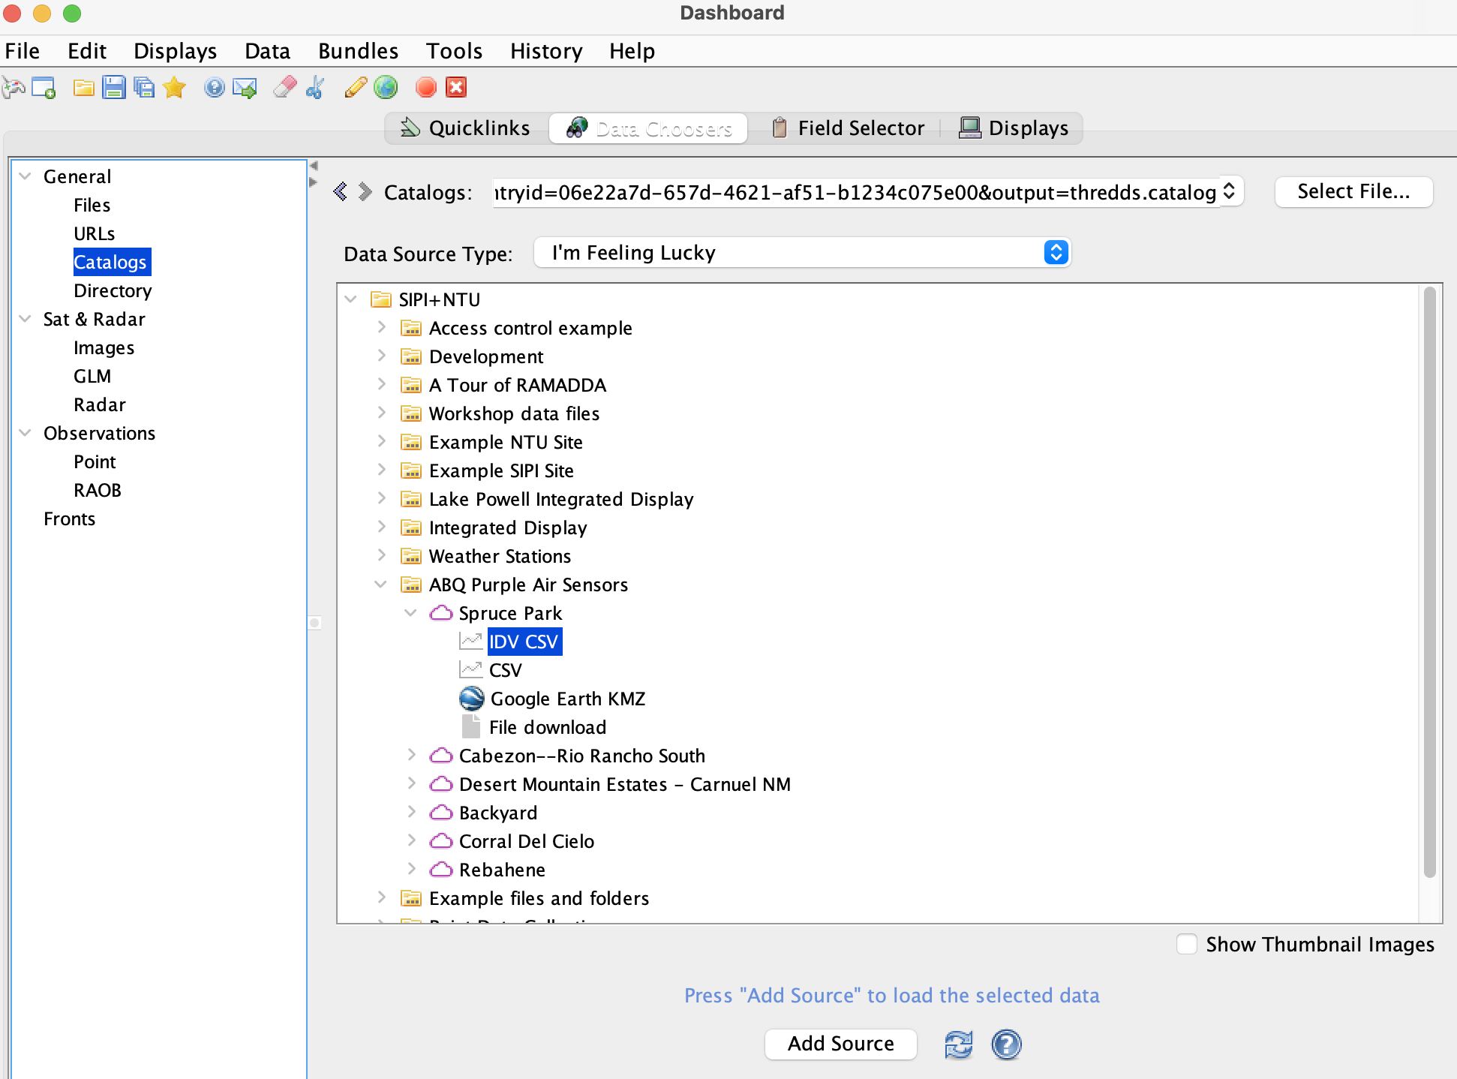
IDV/RAMADDA Catalogs
Now, in the IDV go to the Data Choosers window
In the Catalogs tab paste the URL from RAMADDA
Open ABQ Purple Air Sensors->Spruce Park
Select IDV CSV and press Add Source
Select action

Slide 46
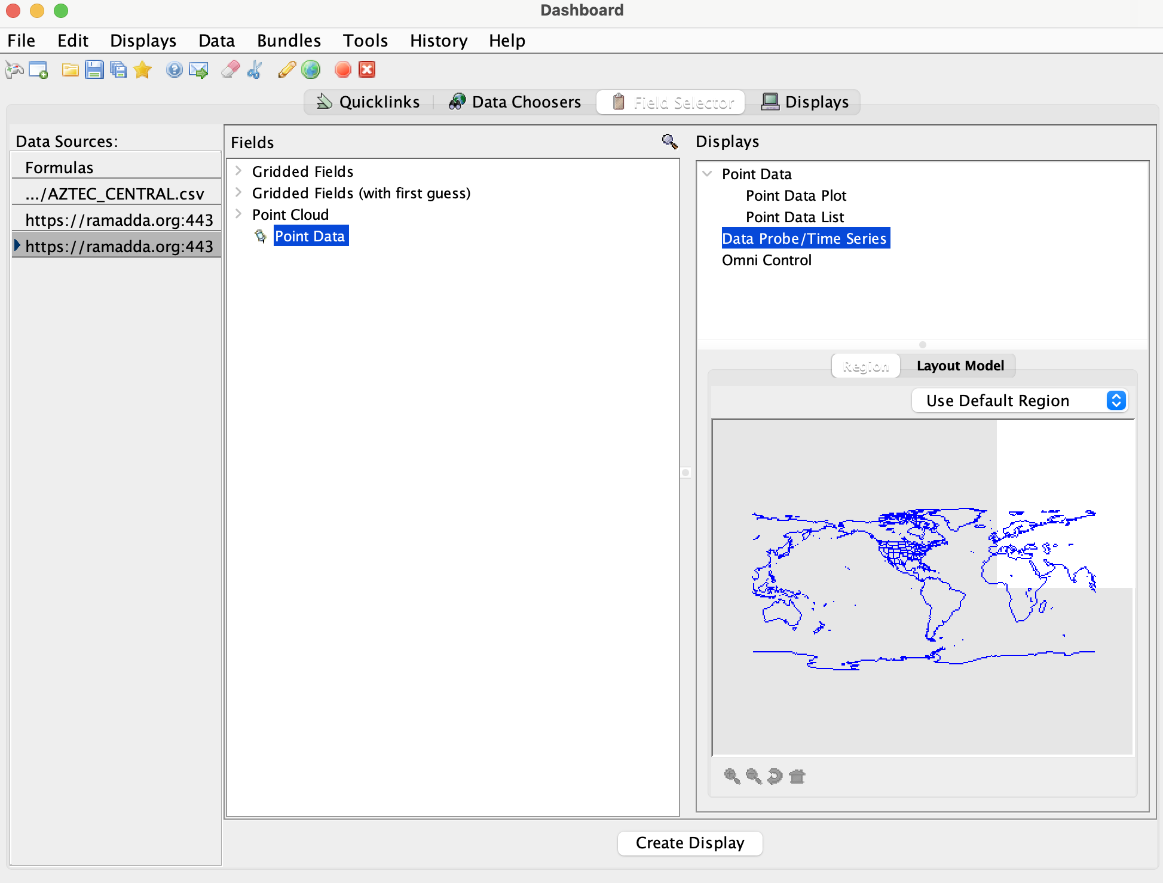
IDV/RAMADDA Catalogs
Choose “Point Data” and “Data Probe/Time Series”
Select display

Slide 47
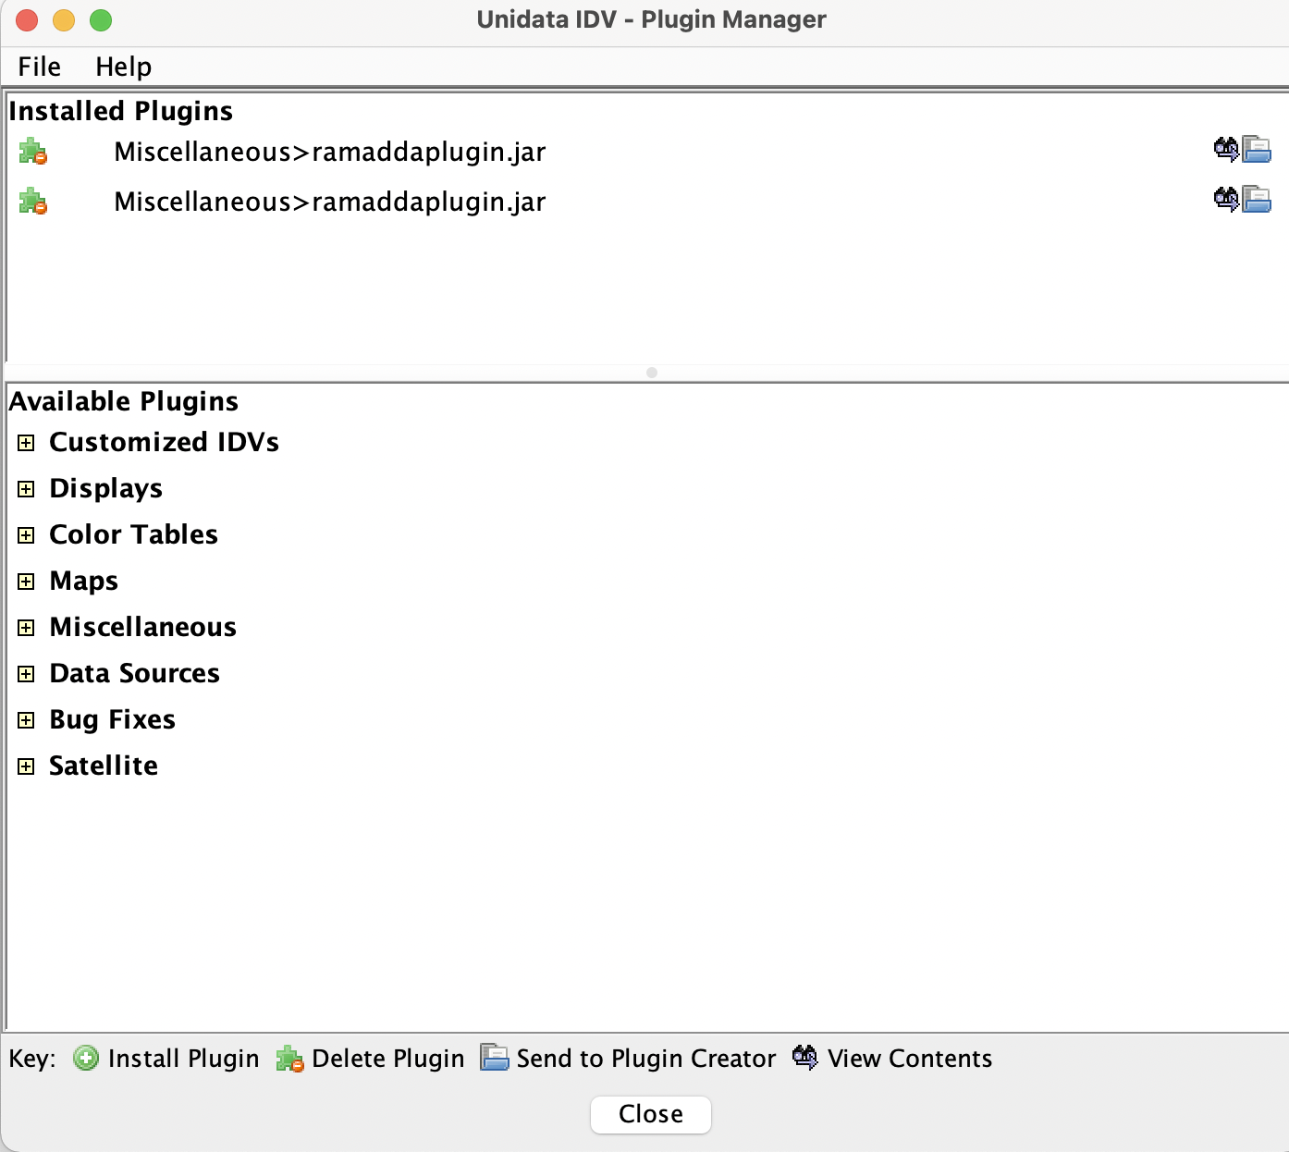
IDV/RAMADDA Publishing
The IDV can publish images, movies, data and bundles to RAMADDA
First, install the RAMADDA publisher plugin to your IDV
Under the Workshop Files download and save the Ramaddapplugin.jar file
In the IDV go to Tools->Plugin Manager
Go to File->Install plugin from file
Select ramaddaplugin.jar
Restart the IDV

Slide 48
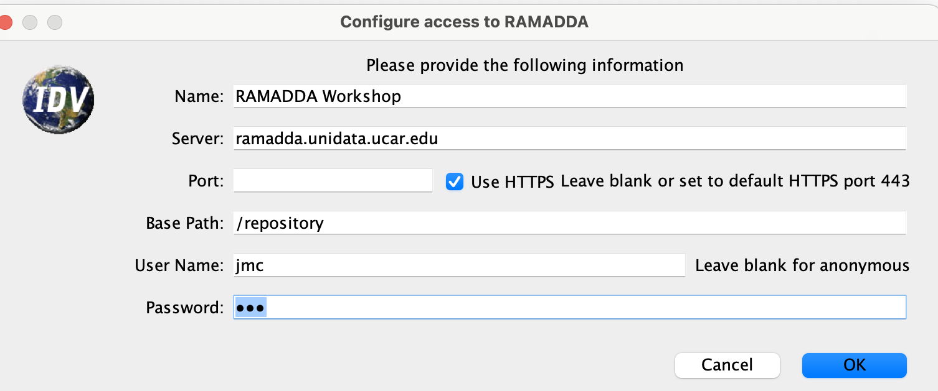
IDV/RAMADDA Publishing
Next, create a new publisher in the IDV
Go to the main File->Publish->New->RAMADDA Publisher menu
Enter the below information
Clear the port and click on Use HTTPS …
Enter your RAMADDA user name and password and press OK

Slide 49
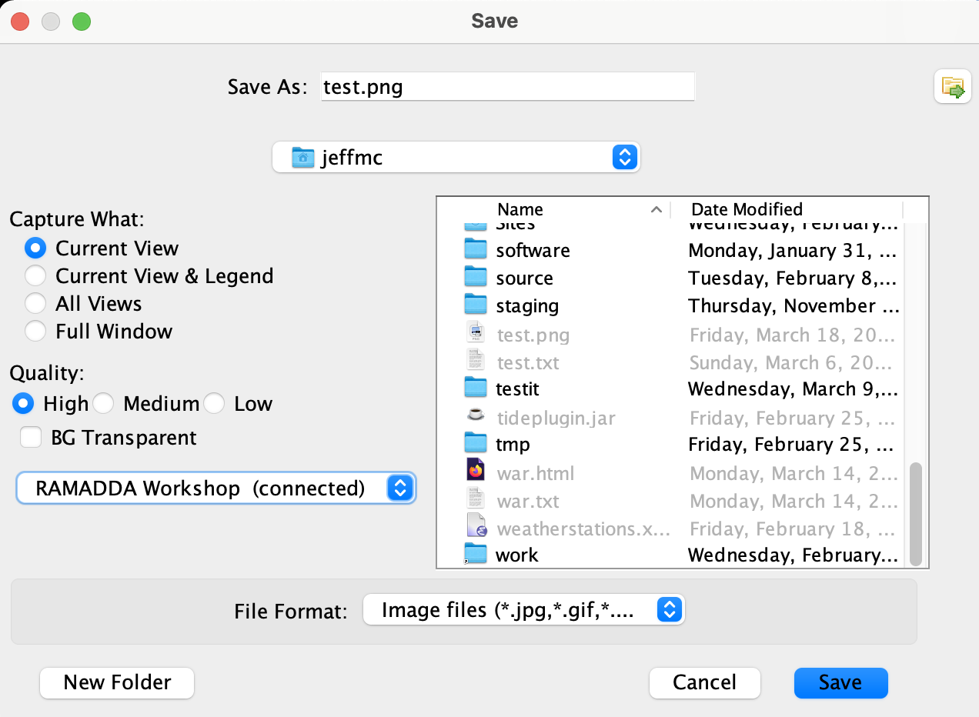
IDV/RAMADDA Publishing
Now, back to the main IDV page.
Under the View menu select Capture->Image…
Select RAMADDA Workshop

Slide 50

IDV/RAMADDA Publishing
This lets you specify the new entry name, description, location, etc
After adding go back to RAMADDA and see the results
Select the destination entry in RAMADDA.
Projects->Unidata DMRC->SIPI+NTU
And press OK

